Slide 1
The Value of Waiting: Farmer Storage Dynamics under Time-Varying Buyer Power
Zhiyao (Yao) Ma
Committee: Richard J. Sexton (Co-Chair), Jeffrey C. Williams (Co-Chair),
and Stephen Boucher
University of California, Davis

Slide 2
1. Motivation: Time-Varying Buyer Power
Farmers producing perishable crops, without access to storage, are often forced to sell quickly and make hasty marketing decisions under pressure
At any given time, buyer competition can be strategically constrained, resulting in artificially low prices
Micro market structure – heterogeneous buyer power:
Spatial heterogeneity: Buyer competition varies across villages
Temporal heterogeneity: Buyer power within the same village changes over time during the marketing season
Intensity of buyer competition varies over time
Storage allows farmers to wait for more competitive market conditions, sell at higher prices, and ultimately improve their welfare
Notes:
另一方面，如果我们从种植易腐农产品（大多数经济作物）的农户的视角看：当他们缺乏合适的/价格合理的仓储时，他们会被迫仓促决策，快速地被动销售，接受被压低的价格。
这就导致到了供应链经典的双重边际化问题。因为中间商的寡头买方势力，农户挣不到钱的同时，消费者也在面临着高昂的食品价格。
换句话说，在任一单一时间点，买方之间的竞争是可被操控的，导致农产品地头价格偏低。
然而，这种竞争程度在更长的时间线上势必存在变化。因此，一个可负担的仓储设施（比如大规模商业冷库）理论上是完全可以帮助农户能够等待市场上买方竞争更充分的时机出售，从而让他们获得更高的销售价格并改善其福利。

Slide 3
1. Motivation: Competitive Effect of Storage Adoption
Visits from outside traders: The arrival of intermediaries from other regions is irregular over time, causing fluctuations in buyer competition throughout the marketing season
Expansion of the sale channels: Farmers with storage access can diversify their sales channels, such as e-commerce, thereby breaking away from the traditional intermediary-dominated system
Warehouses/Storage serve as markets: Commercial storage and cold facilities often evolve into de facto trading hubs, where multiple buyers gather and compete directly on-site, reshaping power relations in the upstream supply chain
Notes:
冷库还会从多个方面改变农户面临的买家之间的市场竞争格局。

Slide 4
1. Motivation: Fresh Apple Industry in China
Fieldwork Observation: Upstream of Fuji Apple Supply Chain in China (Farmer–Middlemen Interactions)
Large Farm–Retail Price Gap: Retail prices at supermarkets (e.g., Carrefour, WuMart) range 6–7.5 RMB/kg, while farm-gate prices remain at 1–3 RMB/kg
Within-Season Price Volatility: Even when downstream retail prices are stable, farm-gate prices fluctuate sharply across selling weeks
Unstable Buyer Collusion and Market Division over time
Pivotal Role of Cold Storage: extend apple’s shelf life from one month to a year
Demo

Slide 5
Month after Harvest
1st Month
2nd Month
Last Month
......
Competitive Level among buyers
?
?
?
......
Outside Buyer
No
?
?
......
Without Storage
(or cost too high)
Weak
Farmer Bargaining Power
With Affordable Storage
Strong
?
......
?
Notes:
如这张图所示，收获期的农户议价力低，或者说买方的寡头垄断水平高。然后一个月、二个月后，一切都是未知数。
当农户配备了可以负担的仓储设施/选择后，他们就可以利用买方势力的时变性和波动性，获得更好的报价。

Slide 6
2. Research Question
Whether and how storage adoption enables farmers to access more competitive procurement market conditions across time, and consequently, increase their welfare?
Notes:
因此，简而言之，我这篇研究聚焦于回答这个核心问题：

Slide 7
3. Literature Review: Buyer Power in Agricultural Markets
Buyer power arises from farmers’ limited outlets, liquidity constraints, and product immobility (Mérel & Sexton 2017)
Classical IO treats buyer power as structural and static, ignoring short-term shocks and trading frictions
In developing markets with weak regulation and informal trade, buyer leverage fluctuates rapidly (Wen 2009)
Gap: Existing models miss temporal variation How market power shifts within a marketing season
Notes:
Mérel and Sexton (2017): IJIO

Slide 8
3. Literature Review: Time-Variability of Buyer Power
Buyer power is often seasonal, localized, and dynamic (Sexton & Xia 2018)
Competition intensity changes with costs, demand, and perishability (Sudhir et al. 2005)
Buyer power are implicitly proven to be time-varying over time:
Developing: China tobacco (Rubens, 2023); Uganda coffee (Fafchamps & Hill, 2005); East African maize (Bergquist $ Dinerstein, 2020)
Developed: U.S. potato and beef (Richards et al., 2001; Ji et al., 2017); Germany dairy (Grau & Hockmann, 2018)
Gap: These studies document fluctuations but stop short of modeling how farmers strategically respond to evolving buyer competition
Notes:
Sexton and Xia (2018) : ARRE
Sudhir et al. (2005) : Management Science
Rubens, (2023): AER
Fafchamps and Hill, (2005): AJAE
Sitko and Jayne, (2014); World Development
Bergquist and Dinerstein, (2020): AER
Richards et al., (2001): AJAE
Grau and Hockmann, (2018) Agribusiness

Slide 9
3. Literature Review: Storage as a Strategic Response
Farmers store output for price arbitrage, consumption smoothing, and precaution (Wright & Williams 1982; Deaton & Laroque 1992)
Also, for intertemporal consumption and safety benefits（Saha, 1994; Park, 2006）
Experimental evidence: Enabling storage through community schemes leads to delayed selling and higher prices in Kenya (Ruhinduka et al., 2020)
Yet storage entails risk, financing costs, and delayed cash flow (Janzen et al. 2024; Cardell & Michelson, 2023)
Inventory–competition interaction in OR fields: Mostly seller-centered, ignore time-varying buyer behavior (Anand & Goyal, 2008)
Notes:
Janzen et al., (2024) AJAE
Cardell and Michelson, (2023) AJAE
Mitra et al., (2018): Review of Economic and Statistics

Slide 10
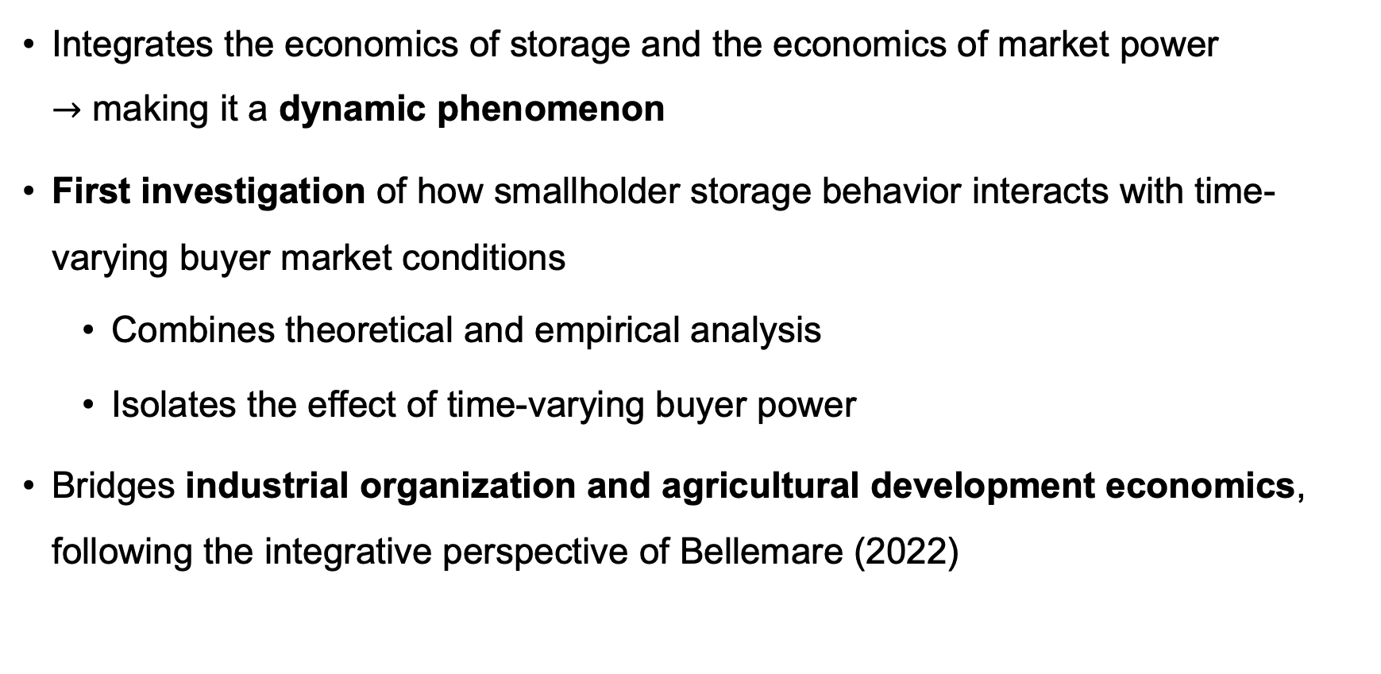
3. Literature Review: My Contribution
Integrates the economics of storage and the economics of market power $→$ making it a dynamic phenomenon
First investigation of how smallholder storage behavior interacts with time-varying buyer market conditions
Combines theoretical and empirical analysis
Isolates the effect of time-varying buyer power
Bridges industrial organization and agricultural development economics, following the integrative perspective of Bellemare (2022)

Slide 11
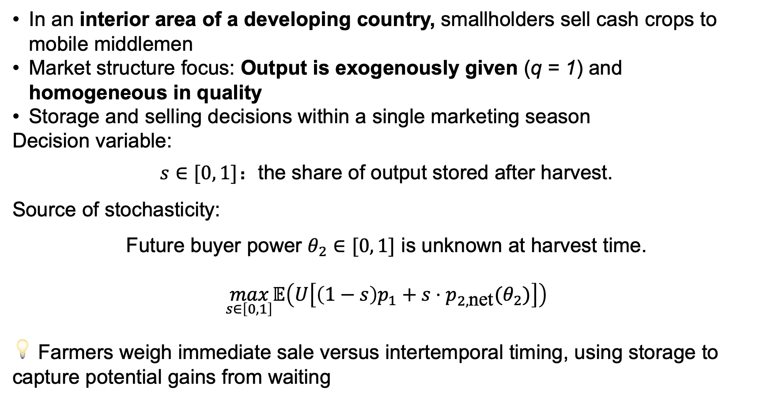
4.1. Conceptual Framework Two-Period Model of Farmer Storage Decisions
In an interior area of a developing country, smallholders sell cash crops to mobile middlemen
Market structure focus: Output is exogenously given (q = 1) and homogeneous in quality
Storage and selling decisions within a single marketing season
Decision variable:
$s∈[0, 1]$：the share of output stored after harvest.
Source of stochasticity:
Future buyer power $θ_{2}∈[0, 1]$ is unknown at harvest time.
$$\max_{s∈\left[0,1\right]}𝔼\left(U\left[\left(1−s\right)p_{1}+s⋅p_{2,\text{net}}(θ_{2})\right]\right)$$
💡 Farmers weigh immediate sale versus intertemporal timing, using storage to capture potential gains from waiting

Slide 12
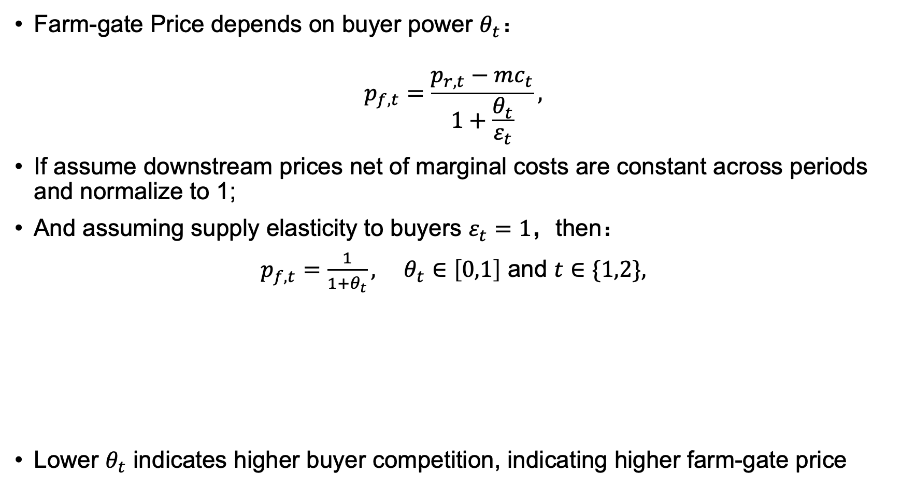
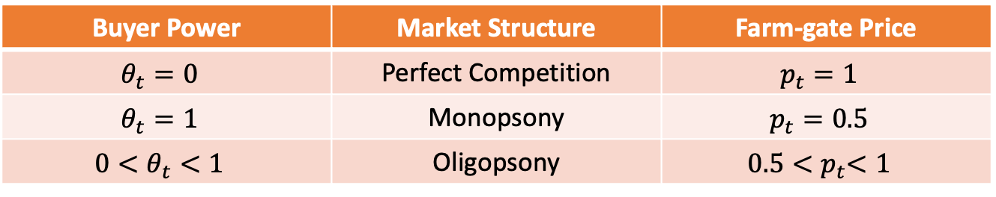
4.2. Buyer Power and Pricing Formation: Based on Flexible Oligopoly/Oligopsony Model
Farm-gate Price depends on buyer power $θ_{t}$：
$$p_{f,t}=\frac{p_{r,t}−mc_{t}}{1+\frac{θ_{t}}{ε_{t}}},$$
If assume downstream prices net of marginal costs are constant across periods and normalize to 1;
And assuming supply elasticity to buyers $ε_{t}=1$，then：
$p_{f,t}=\frac{1}{1+θ_{t}}, θ_{t}∈\left[0,1\right] \text{and} t∈\{1,2\},$
Lower $θ_{t}$ indicates higher buyer competition, indicating higher farm-gate price
Derivation
Buyer Power | Market Structure | Farm-gate Price
$$θ_{t}=0$$ | Perfect Competition | $$p_{t}=1$$
$$θ_{t}=1$$ | Monopsony | $$p_{t}=0.5$$
$$0<θ_{t}<1$$ | Oligopsony | $$0.5{<p}_{t}<1$$

Slide 13
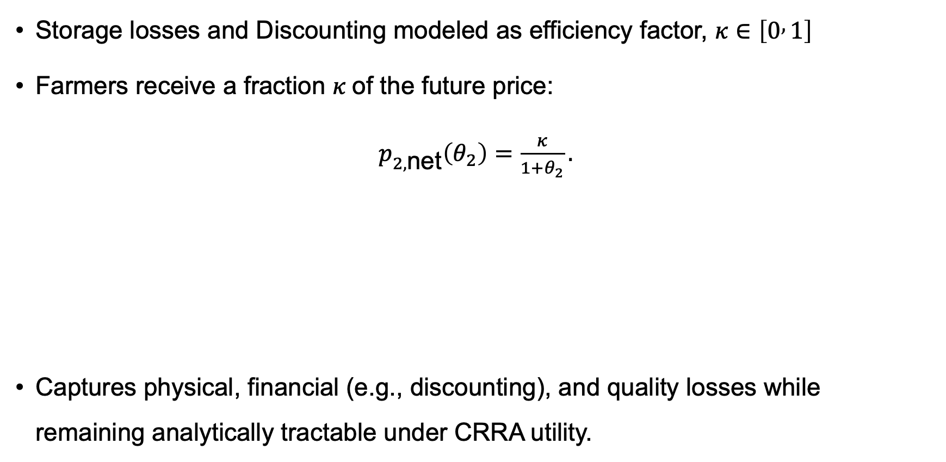
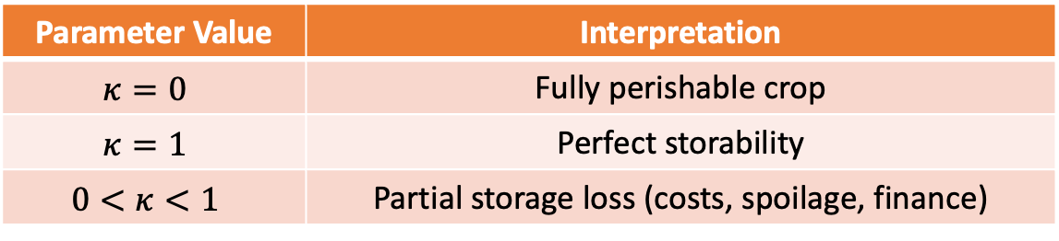
4.3. Storage Efficiency: A Proportional Specification of Storage Loss and Discounting
Storage losses and Discounting modeled as efficiency factor, $κ∈\left[0 , 1\right]$
Farmers receive a fraction $κ$of the future price:
$p_{2,\text{net}}\left(θ_{2}\right)=\frac{κ}{1+θ_{2}}.$
Captures physical, financial (e.g., discounting), and quality losses while remaining analytically tractable under CRRA utility.
Parameter Value | Interpretation
$$κ=0$$ | Fully perishable crop
$$κ=1$$ | Perfect storability
$$0<κ<1$$ | Partial storage loss (costs, spoilage, finance)

Slide 14
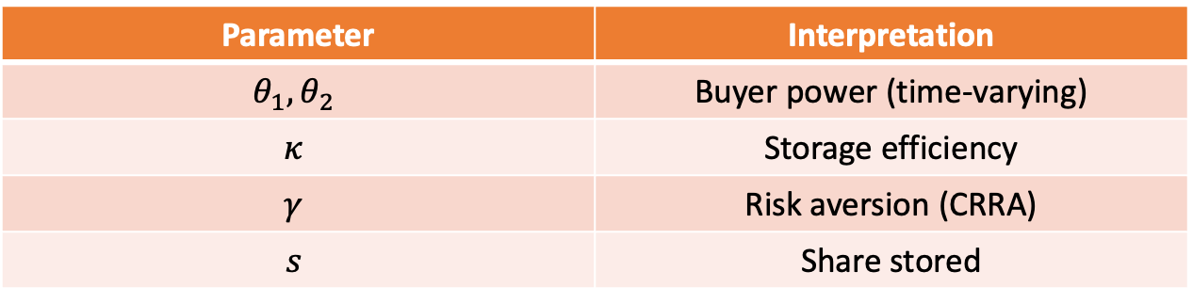
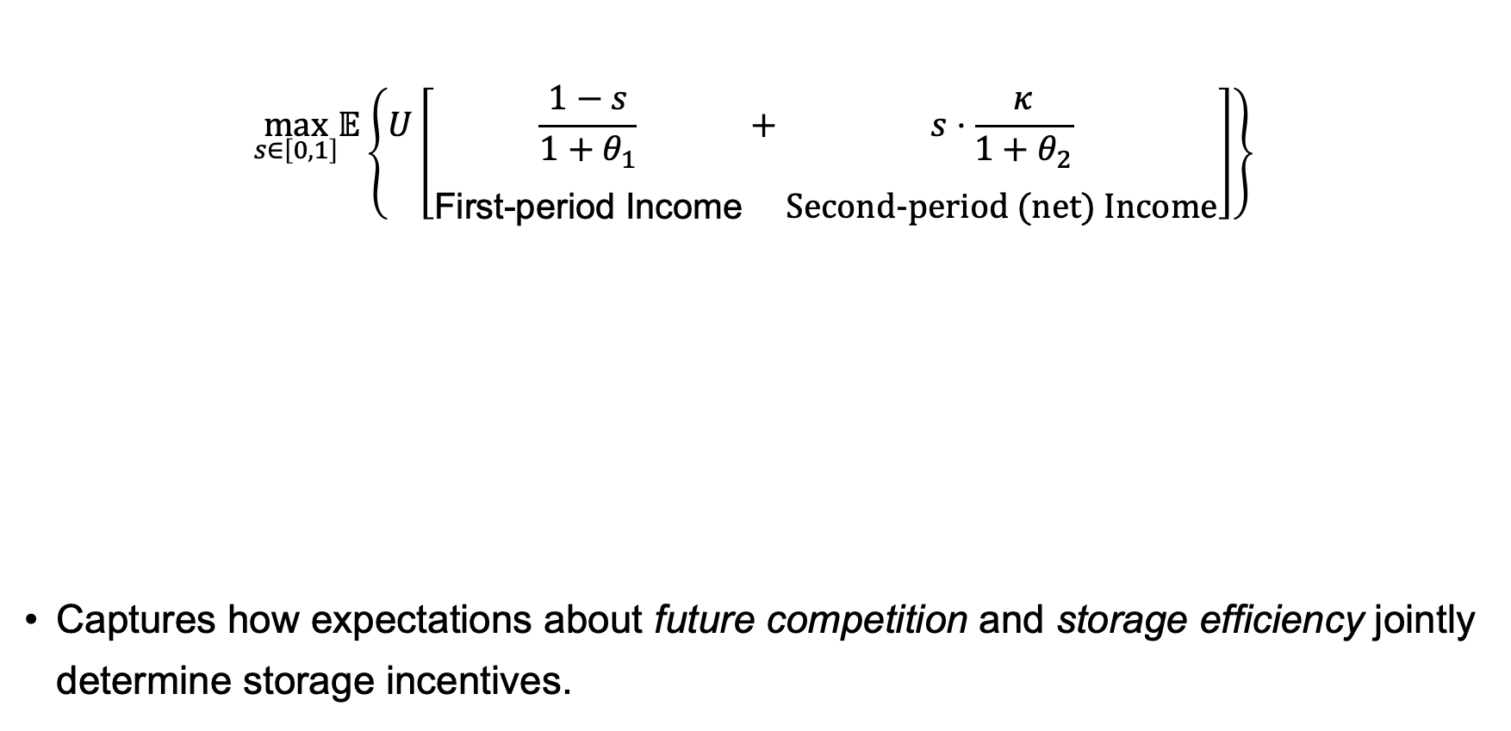
4.4. Farmer’ Inter-Temporal Storage Problem
$$\max_{s∈\left[0,1\right]}𝔼\left\{U\left[\underset{\text{First}\text{−}\text{period} \text{Income}}{\underset{}{\frac{1−s}{1+θ_{1}}}}+\underset{\text{Second}\text{−}\text{period}\text{ (}\text{net}\text{) }\text{Income}}{\underset{}{s⋅\frac{κ}{1+θ_{2}}}}\right]\right\}$$
Captures how expectations about future competition and storage efficiency jointly determine storage incentives.
Parameter | Interpretation
$$θ_{1}, θ_{2}$$ | Buyer power (time-varying)
$$κ$$ | Storage efficiency
$$γ$$ | Risk aversion (CRRA)
$$s$$ | Share stored

Slide 15
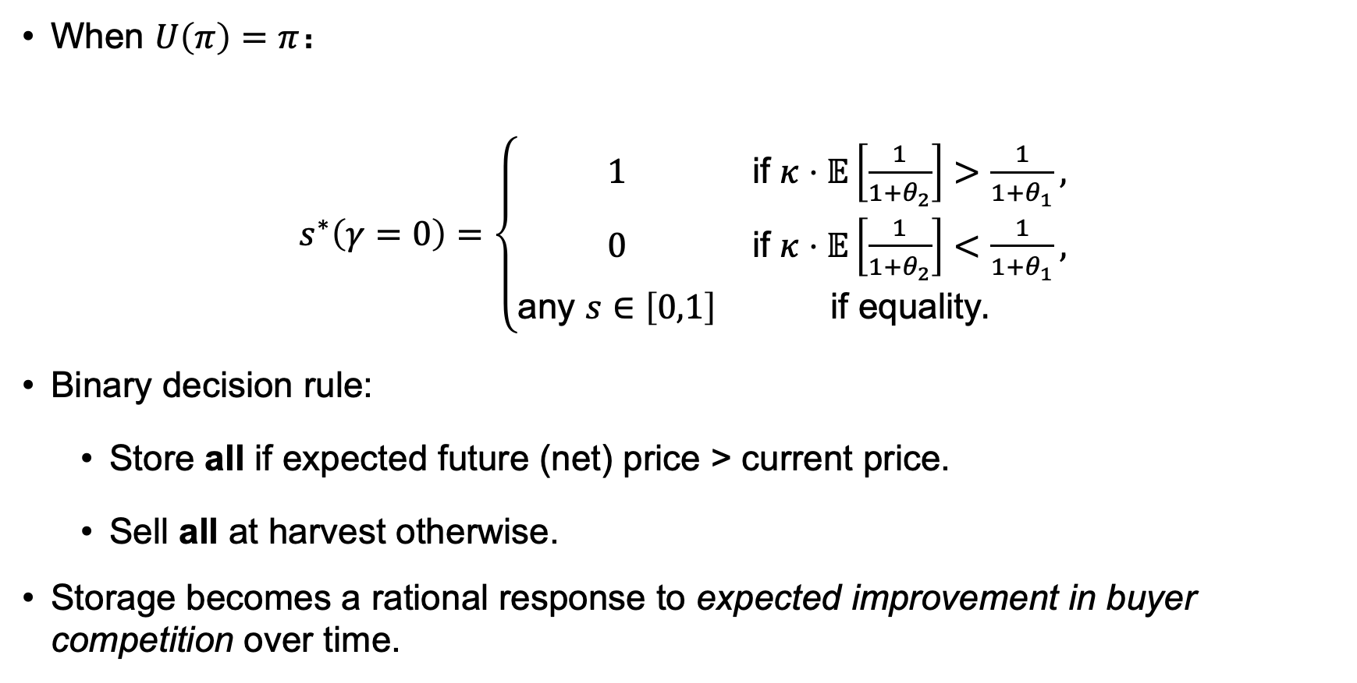
4.5. Risk Neutrality: Analytical Solution
When $U\left(π\right)=π$：
$s^{∗}\left(γ=0\right)=\left\{\begin{matrix}1 & \text{if} κ⋅𝔼\left[\frac{1}{1+θ_{2}}\right]>\frac{1}{1+θ_{1}}, \\ 0 & \text{if} κ⋅𝔼\left[\frac{1}{1+θ_{2}}\right]<\frac{1}{1+θ_{1}}, \\ \text{any} s∈\left[0,1\right] & \text{if} \text{equality}.\end{matrix}\right.$
Binary decision rule:
Store all if expected future (net) price > current price.
Sell all at harvest otherwise.
Storage becomes a rational response to expected improvement in buyer competition over time.

Slide 16
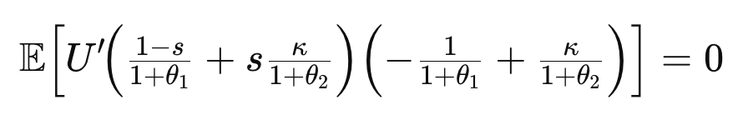
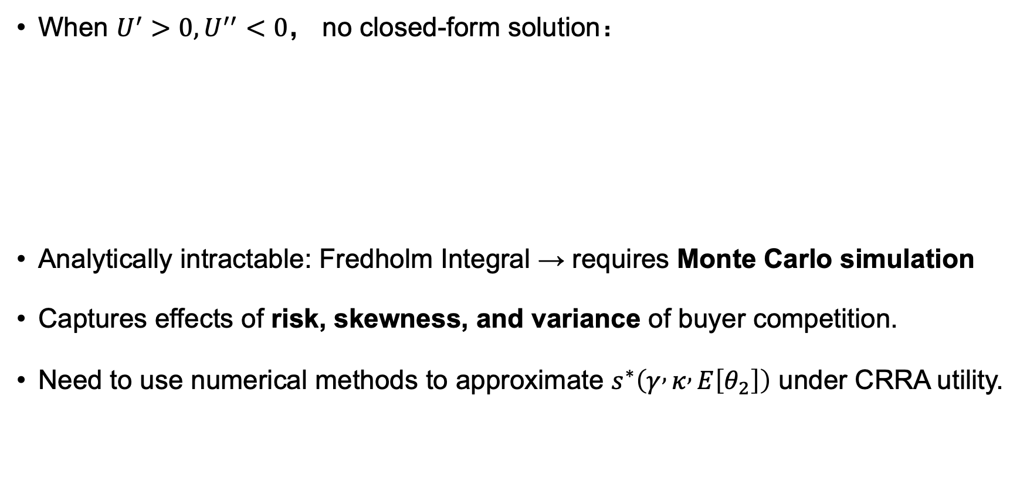
4.6. Risk Aversion: Numerical Solution
When $U^{′}>0,U^{′′}<0$， no closed-form solution：
Analytically intractable: Fredholm Integral → requires Monte Carlo simulation
Captures effects of risk, skewness, and variance of buyer competition.
Need to use numerical methods to approximate $s^{∗}\left(γ , κ , E\left[θ_{2}\right]\right)$ under CRRA utility.

Slide 17
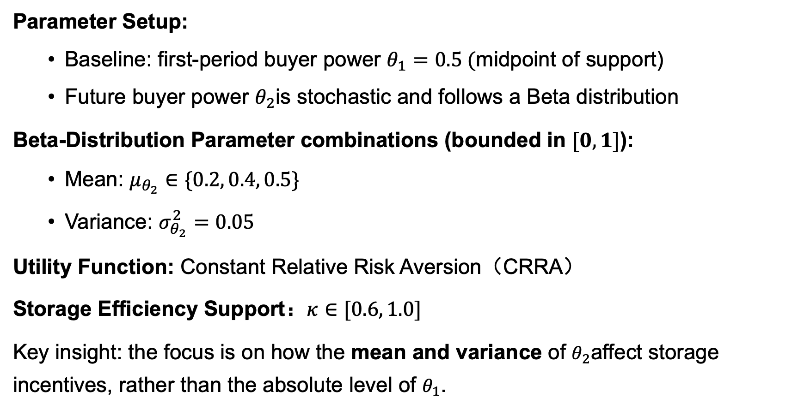
5.1. Simulation Design
Parameter Setup:
Baseline: first-period buyer power $θ_{1}=0.5 ($midpoint of support)
Future buyer power $θ_{2}$is stochastic and follows a Beta distribution
Beta-Distribution Parameter combinations (bounded in $[0, 1]$):
Mean: $μ_{θ_{2}}∈\{0.2, 0.4, 0.5\}$
Variance: $σ_{θ_{2}}^{2}=0.05$
Utility Function: Constant Relative Risk Aversion（CRRA）
Storage Efficiency Support：$κ∈[0.6, 1.0]$
Key insight: the focus is on how the mean and variance of $θ_{2}$affect storage incentives, rather than the absolute level of $θ_{1}$.

Slide 18
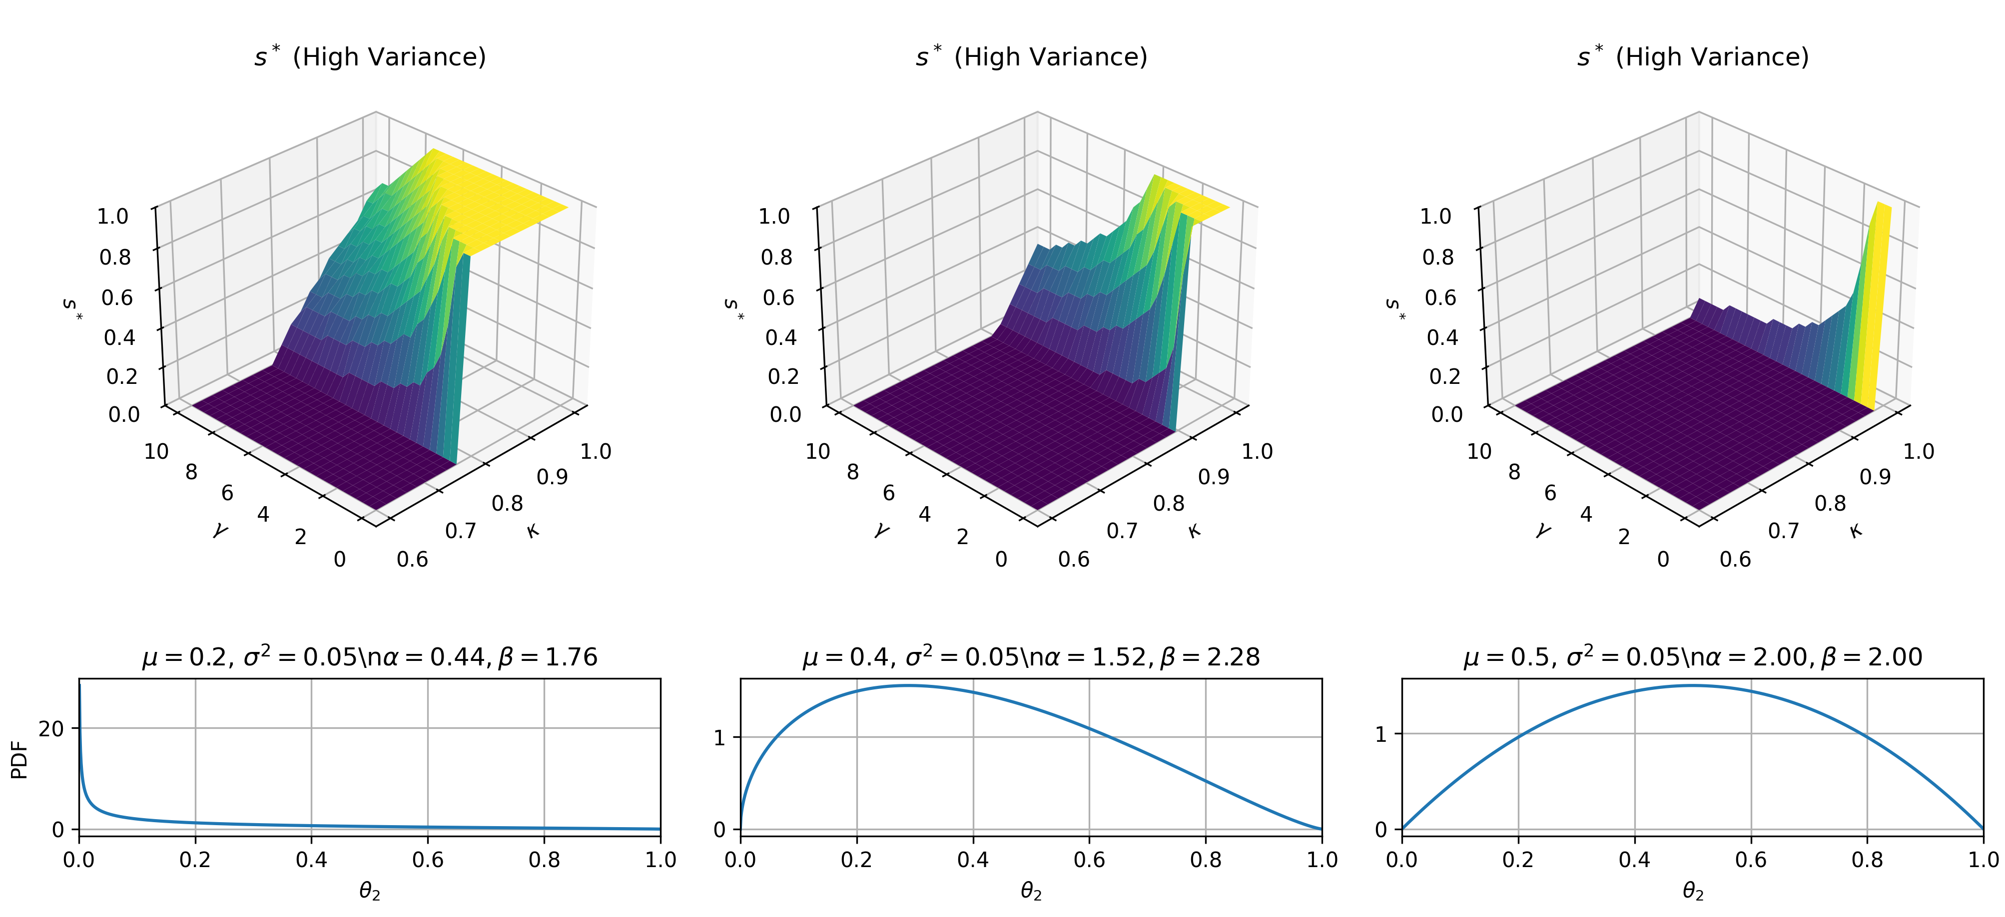
5.2. Simulation of Optimal Storage Shares
More Comparisons
Sensitivity check:
Future Buyer Power
Risk Aversion
Storage Efficiency

Slide 19
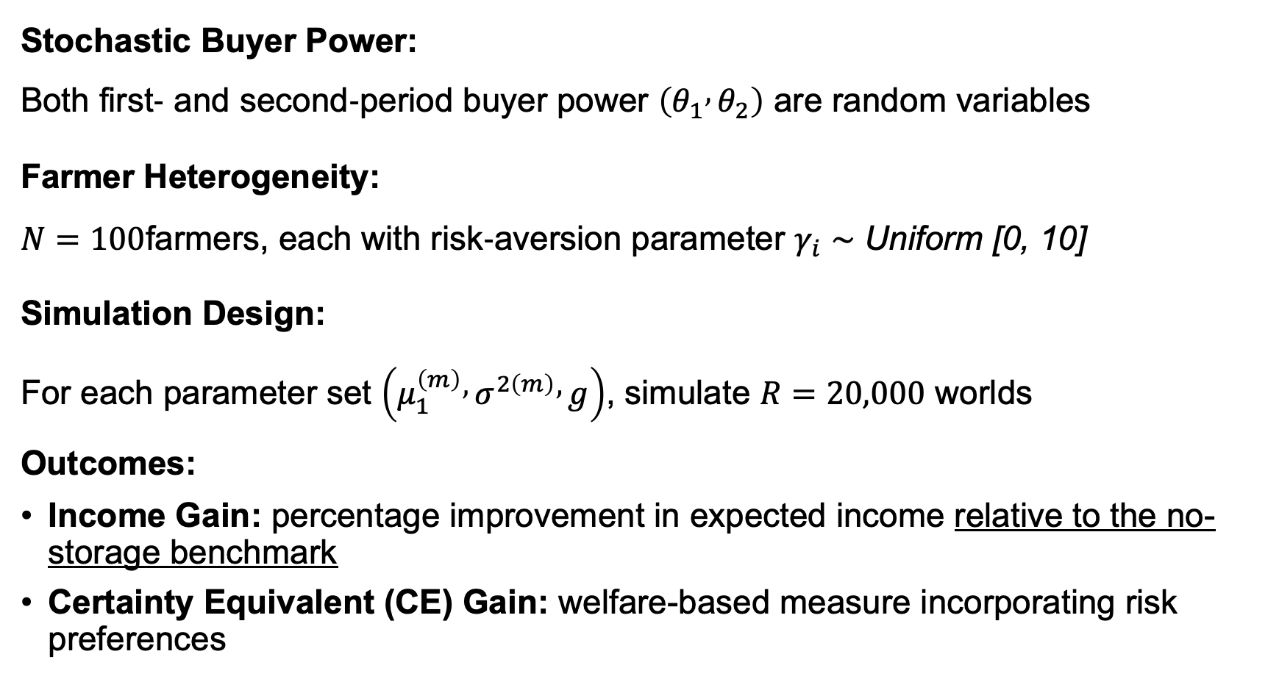
5.3. Village-level Welfare Simulation
Stochastic Buyer Power: Both first‐ and second‐period buyer power $\left(θ_{1} , θ_{2}\right)$ are random variables
Farmer Heterogeneity: $N=100$farmers, each with risk‐aversion parameter $γ_{i}∼\text{Uniform}\text{ [0, 10]}$
Simulation Design: For each parameter set $\left(μ_{1}^{\left(m\right)} , σ^{2\left(m\right)} , g\right)$, simulate $R=20,000$ worlds
Outcomes:
Income Gain: percentage improvement in expected income relative to the no-storage benchmark
Certainty Equivalent (CE) Gain: welfare-based measure incorporating risk preferences
Notes:
确定性等价（Certainty-Equivalent, CE）指的是：在存在不确定收益的情况下，使个体获得与该不确定收益带来相同效用水平的确定金额。

Slide 20
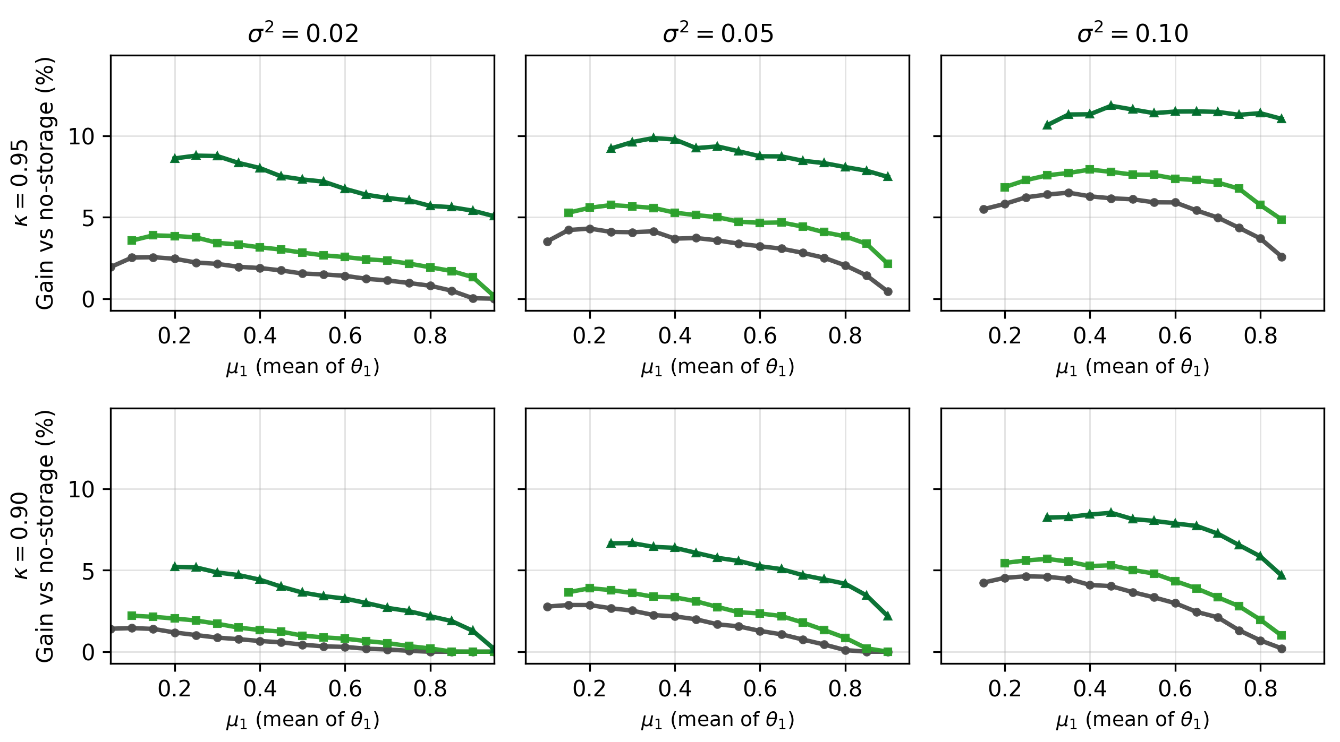
5.3. Village-level Welfare Simulation:
Percent Expected Income Gain relative to No-Storage
Why Inverted-U Shape?
CE Improvement
Notes:
Efficiency & volatility both raise gains. Higher storage efficiency ($κ$) and greater buyer-power variance ($σ^{2}$) systematically increase welfare gains from storage (option-value logic via $p\left(θ\right)=1/\left(1+θ\right)$convexity).
Intertemporal beliefs matter. Anticipating weaker buyer power in period 2 ($μ_{2}<μ_{1})$ materially lifts gains; the vertical spread between curves quantifies this belief premium.
Risk aversion disciplines patterns. While expected gains can exhibit an inverted-U in $μ_{1}$under high $κ$and high $σ^{2}$, certainty-equivalent (CE) gains decline monotonically in $μ_{1}$; the non-monotonicity vanishes once utility curvature is considered.

Slide 21
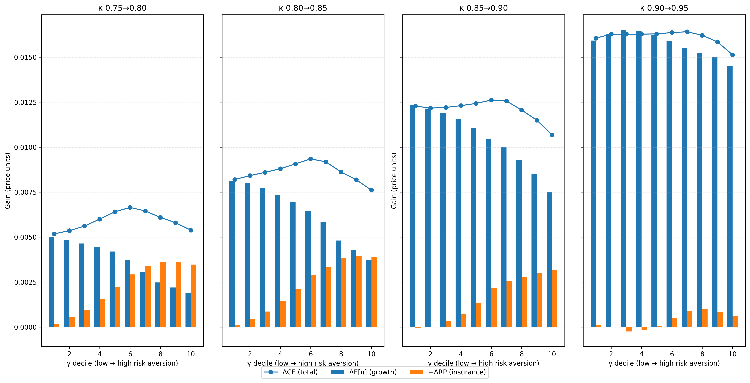
5.3. Village-level Welfare Simulation: Welfare decomposition at different initial efficiency
Notes:
Two channels, potentially super-additive. Raising $κ$transfers surplus to infra-marginal storers and shifts the marginal adoption threshold, enabling new storers to access more competitive second-period markets—amplifying aggregate gains.
Convexity in $κ$. Incremental welfare effects are larger when baseline $κ$is already high: both intensive (more stored) and extensive (more adopters) margins strengthen.
Heterogeneous distributional impacts. At low $κ$, gains are insurance-dominated and concentrated among more risk-averse farmers; at high $κ$, gains come mainly from income growth. Policy should target local baselines rather than apply uniform subsidies.

Slide 22
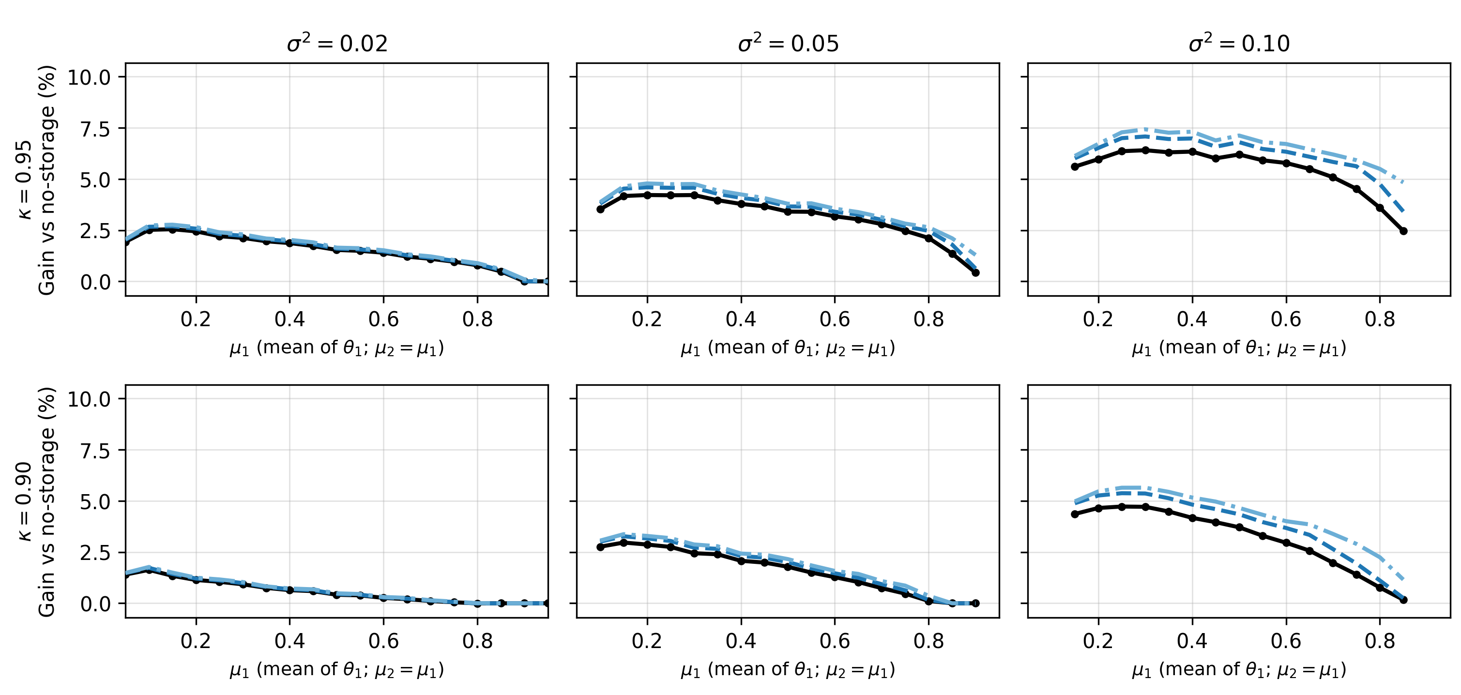
5.3. Village-level Welfare Simulation: Percent income gain by risk-aversion level
Notes:
Lower prudence unlocks timing value. Reducing risk aversion shifts heterogeneous-$γ$ outcomes toward the risk-neutral envelope, especially when $σ^{2}$and $κ$are high and $μ$is interior.
Limited effect in low-return settings. When $κ$and $σ^{2}$are low (and $μ$unfavorable), all profiles converge—little to gain from altering risk attitudes.

Slide 23
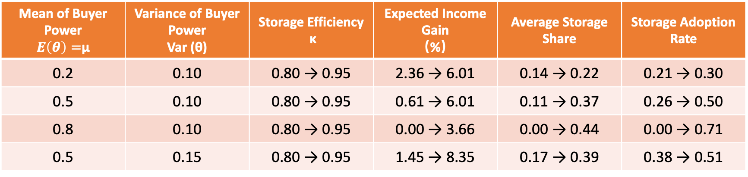
5.3. Village-level Welfare Simulation: Simulation under equal expected buyer power
Mean of Buyer Power $E\left(θ\right)=$μ | Variance of Buyer Power Var (θ) | Storage Efficiency κ | Expected Income Gain （%） | Average Storage Share | Storage Adoption Rate
0.2 | 0.10 | 0.80 → 0.95 | 2.36 → 6.01 | 0.14 → 0.22 | 0.21 → 0.30
0.5 | 0.10 | 0.80 → 0.95 | 0.61 → 6.01 | 0.11 → 0.37 | 0.26 → 0.50
0.8 | 0.10 | 0.80 → 0.95 | 0.00 → 3.66 | 0.00 → 0.44 | 0.00 → 0.71
0.5 | 0.15 | 0.80 → 0.95 | 1.45 → 8.35 | 0.17 → 0.39 | 0.38 → 0.51
Policies that lower effective storage costs or fixed adoption hurdles yield the highest returns where volatility is substantial and buyer power is moderate
Broad but shallow adoption. Volatility and efficiency raise participation more than average storage shares—welfare comes from flexible timing rather than large volumes

Slide 24
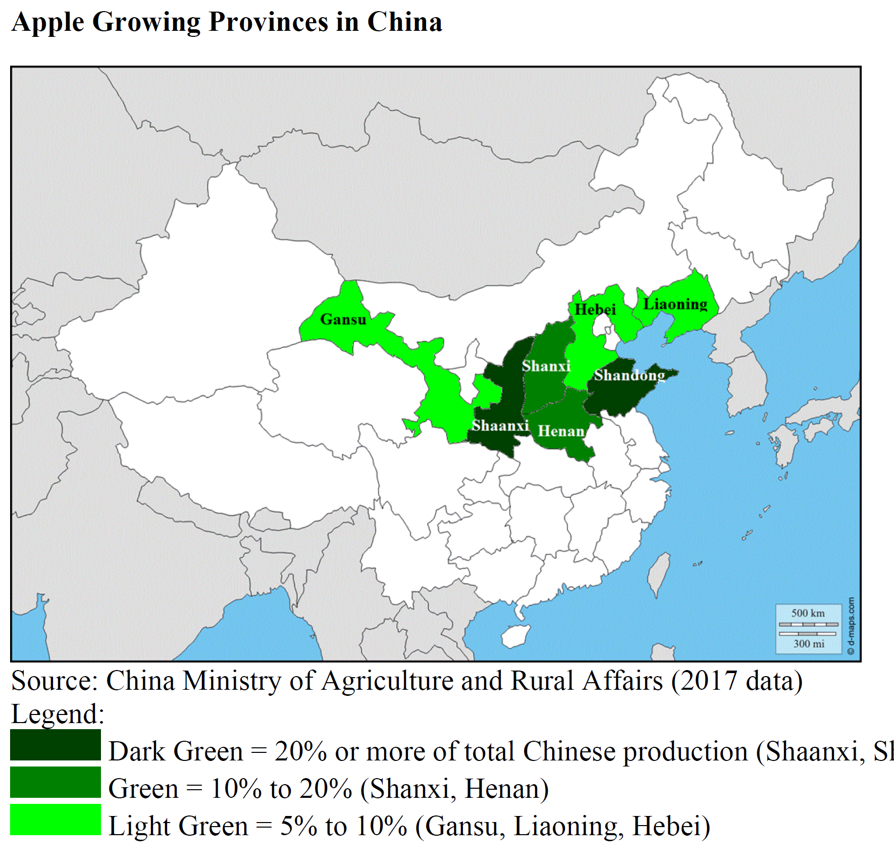
6.1. Why Fresh Apple Industry in China?
Overview of Fresh Apple Industry in China
Reason of Fieldwork: Existing data lack measures of intertemporal buyer competition
Storage effect: Cold storage extends apple shelf life by 8–10 months, enabling delayed sales.
Relevance: Storage plays a crucial bargaining role

Slide 25
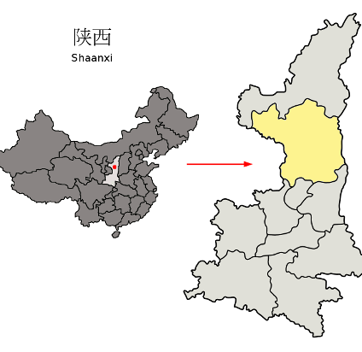
6.2. Field Site: A County Case in Central China
Location: Yanchang County
Features: Smallholders are highly dependent on a single cash crop
Storage conditions: Farmers can rent or self-build storage facilities for post-harvest storage
Current status: Vast majority rely on rented facilities

Slide 26
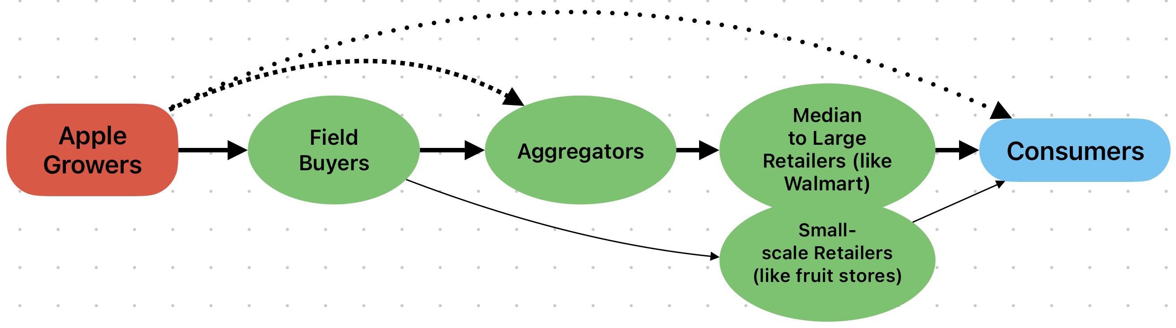
6.2. Field Site: Fresh-Apple Supply Chain in China
Overall structure: Up to three intermediary layers: field buyers, wholesalers, and retailers While the types of intermediaries remain relatively stable, their roles shift flexibly over time in response to market conditions

Slide 27
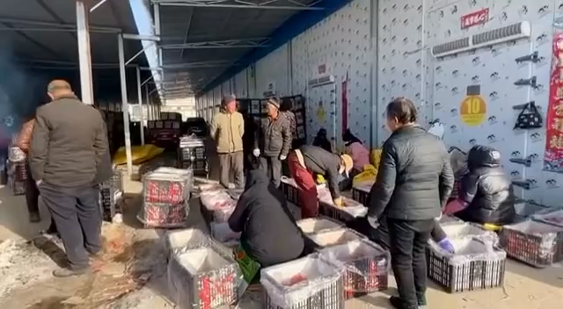
6.2. Field Site: A Glance at On-farm Storage and Selling

Slide 28
6.3.Survey and Key Dependent Variables
Main household survey: October–December 2024, carried out in collaboration with the Yanchang County Women’s Federation
Sample criteria: Smallholders for whom apples account for at least 90% of agricultural income, with farm size below 50 mu (≈ 8 acres)
Ethical approval: Approved by the UC Davis IRB in June 2023
Key dependent variables:
Storage-Usage-Binary: Whether the farmer used cold storage (1 = yes, 0 = no)
Storage-Usage-Type: Four categories — no storage, rented large facility, rented small facility, self-built cold storage
Time-to-Sell: Interval between harvest and sale (in weeks)
Notes:
Sampling design: Single-stage, geographically stratified random sampling. Eight townships were sampled with proportional weights based on the number and density of apple growers (30%, 15%, 15%, 15%, 10%, 5%, 5%, 5%). Eligible farmers were randomly selected from village rosters within each township.
Sampling details: To ensure sufficient representation, a minimum of 10 households per township was required; no village-level quota was imposed.

Slide 29
6.4. Measuring Buyer Competition
Farmers’ subjective market competition:
Self-reported buyer competition rating at harvest (1–5 scale)
Expectations about buyer numbers over the next three months
Buyer survey (December 2024):
15 buyers interviewed, including five major local intermediaries.
Collected data on villages purchased from and cold storage facilities used.
Constructed a village-level buyer concentration index to capture intertemporal buyer competition.

Slide 30
6.5. Summary of Statistics
Final sample: 549 apple-growing households, of which 200 used cold storage (33 self-built, 49 small rented, 118 large rented).
Storers tend to be younger, more risk-neutral, better endowed with labor and social capital, and operate at larger scale with higher income levels.
Figure：by storage usage type
Variable | Storers (N=200) | Non-Storers (N=349) | Significance
Age | 56.87 | 60.35 | p<0.01
CRRA Coefficient | 0.09 | 0.36 | p<0.01
Labor Force (#) | 1.74 | 1.60 | p<0.05
Ever be a Village Leader (0/1) | 24% | 6% | p<0.01
Education Level | 1.96 | 1.81 | p<0.05
Cultivation Area (Acre) | 2.60 | 1.72 | p<0.01
Income from Apples (USD) | 10,127 | 8,289 | p<0.01
Liquidity Constrained (0/1) | 15% | 16% | No

Slide 31
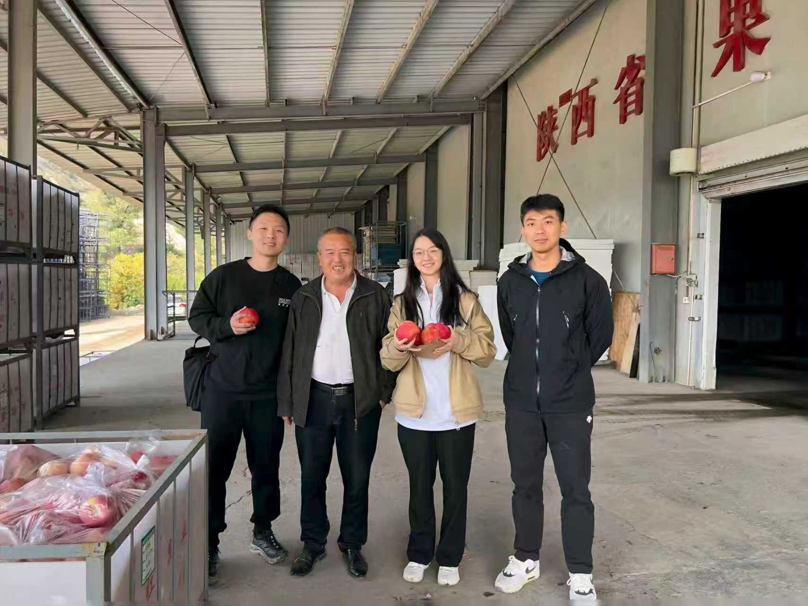
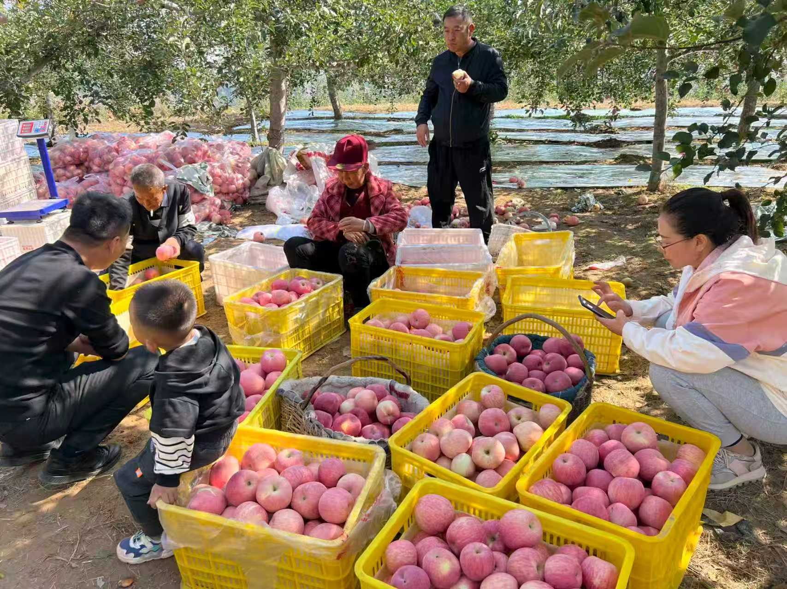
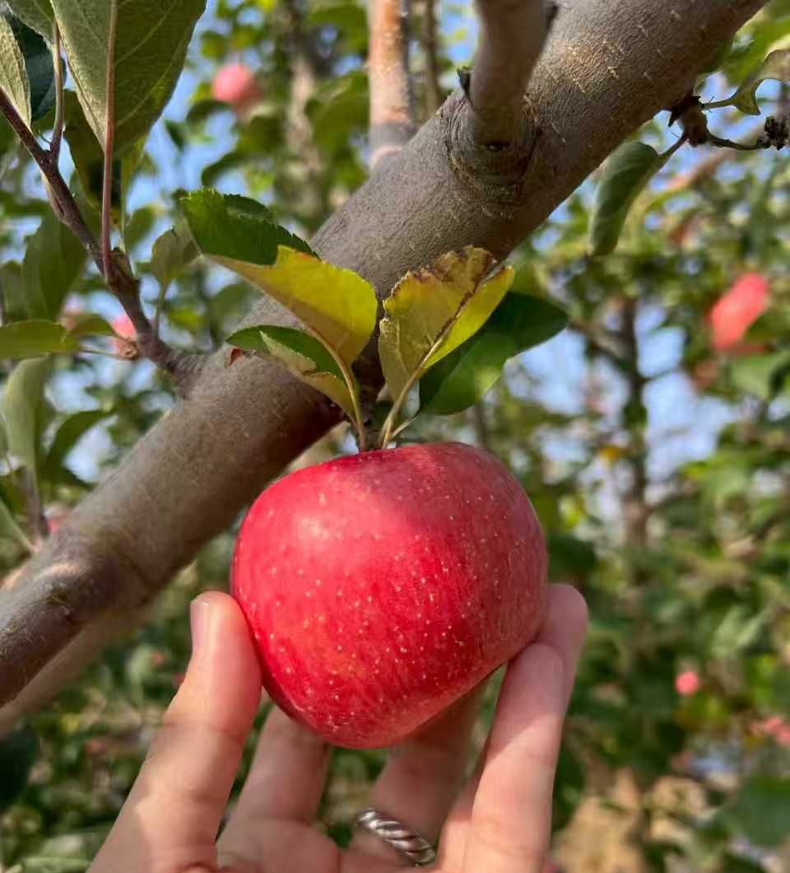
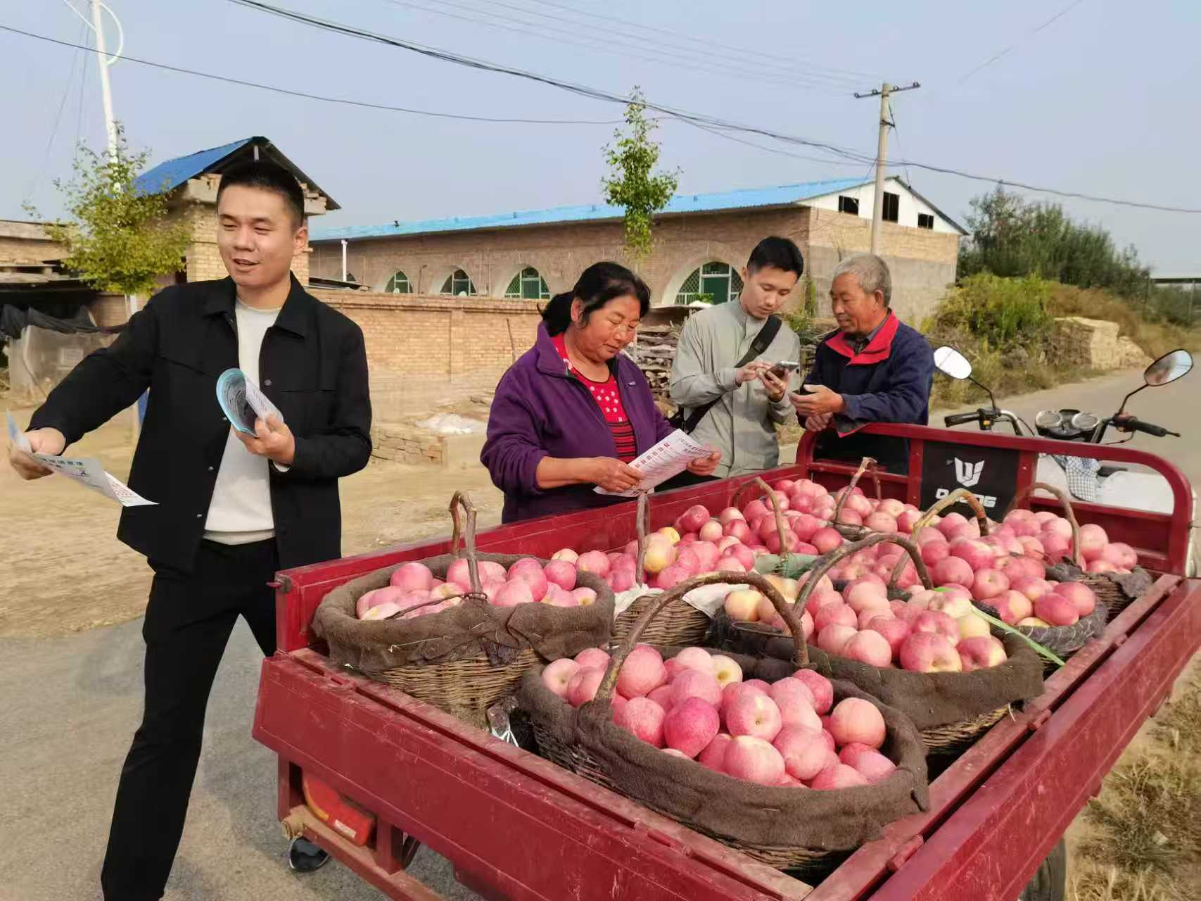
Pictures in fieldwork：Apple Orchards, Storage Facilities, and Selling

Slide 32
6.5. Summary of Statistics
Market behavior & expectations
Relational sales: 40% (storers) vs. 26% (non-storers)
WeChat sales: 15% vs. 0%
Expect more buyers: 46% vs. 6% → Storers show higher market confidence and stronger bargaining power
Prices & risk
Avg. price: 5.96 RMB/kg (non-storers); storers earn +0.45 RMB/kg
Storage cost: 0.40–0.50 RMB/kg → net returns ≈ 0 on average → Storage is risky but can yield intertemporal gains
Reason why not use | Ratio
Not optimistic in price | 60.8%
Too risky | 28.7%
High Cost | 22.9%
Already has contract | 8.0%

Slide 33
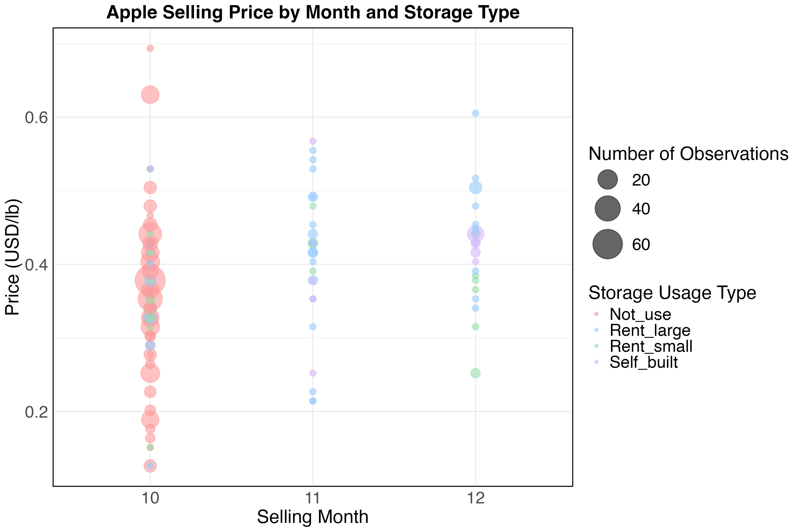
6.5. Summary of Statistics： Transaction Price Movement after Harvest
October prices are more dispersed.
Using cold storage does not guarantee a higher price
But it creates the opportunity to obtain one.
Pre-Survey Price Trend

Slide 34
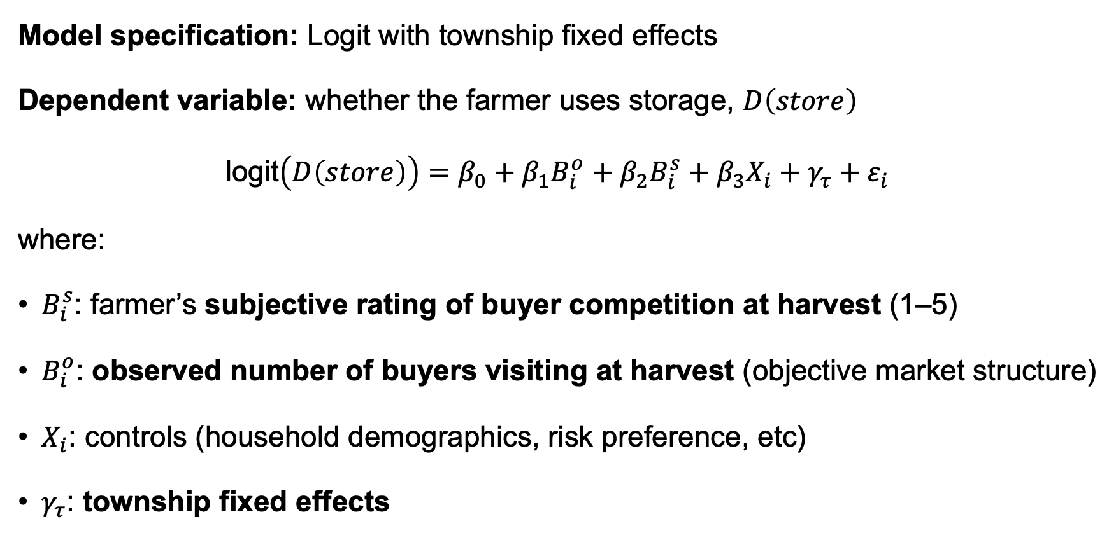
6.6. Farmer Storage Decisions: Buyers' Competitiveness at Harvest
Model specification: Logit with township fixed effects
Dependent variable: whether the farmer uses storage, $D\left(store\right)$
$\text{logit}\left(D\left(store\right)\right)=β_{0}+β_{1}B_{i}^{o}+β_{2}B_{i}^{s}+β_{3}X_{i}+γ_{τ}+ε_{i}$
where:
$B_{i}^{s}$: farmer’s subjective rating of buyer competition at harvest (1–5)
$B_{i}^{o}$: observed number of buyers visiting at harvest (objective market structure)
$X_{i}$: controls (household demographics, risk preference, etc)
$γ_{τ}$: township fixed effects

Slide 35
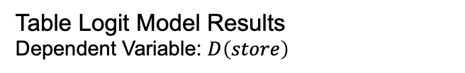
6.6. Farmer Storage Decisions: Buyers' Competitiveness at Harvest
Table Logit Model Results
Dependent Variable: $D\left(store\right)$
Main Findings
Subjective perceptions shape storage decisions far better than objective measures
Perceived strong buyer competition at harvest reduces storage likelihood by ~19 pp
Farmers base decisions on experience and perception rather than observable structure
Suggests possible explicit or tacit buyer collusion
Variable | Average Marginal Effect | Significance
Subjective Rating of Buyer Competition | -0.192 | p<0.01
# of Buyer Visit | +0.056 | NO
Age | -0.003 | p<0.1
Education | +0.038 | p<0.05
Village Leader Family | +0.152 | p<0.01
Risk Aversion | -0.122 | p<0.01
Liquidity Constrained | -0.004 | NO
Farmers’ Price Info Sources

Slide 36
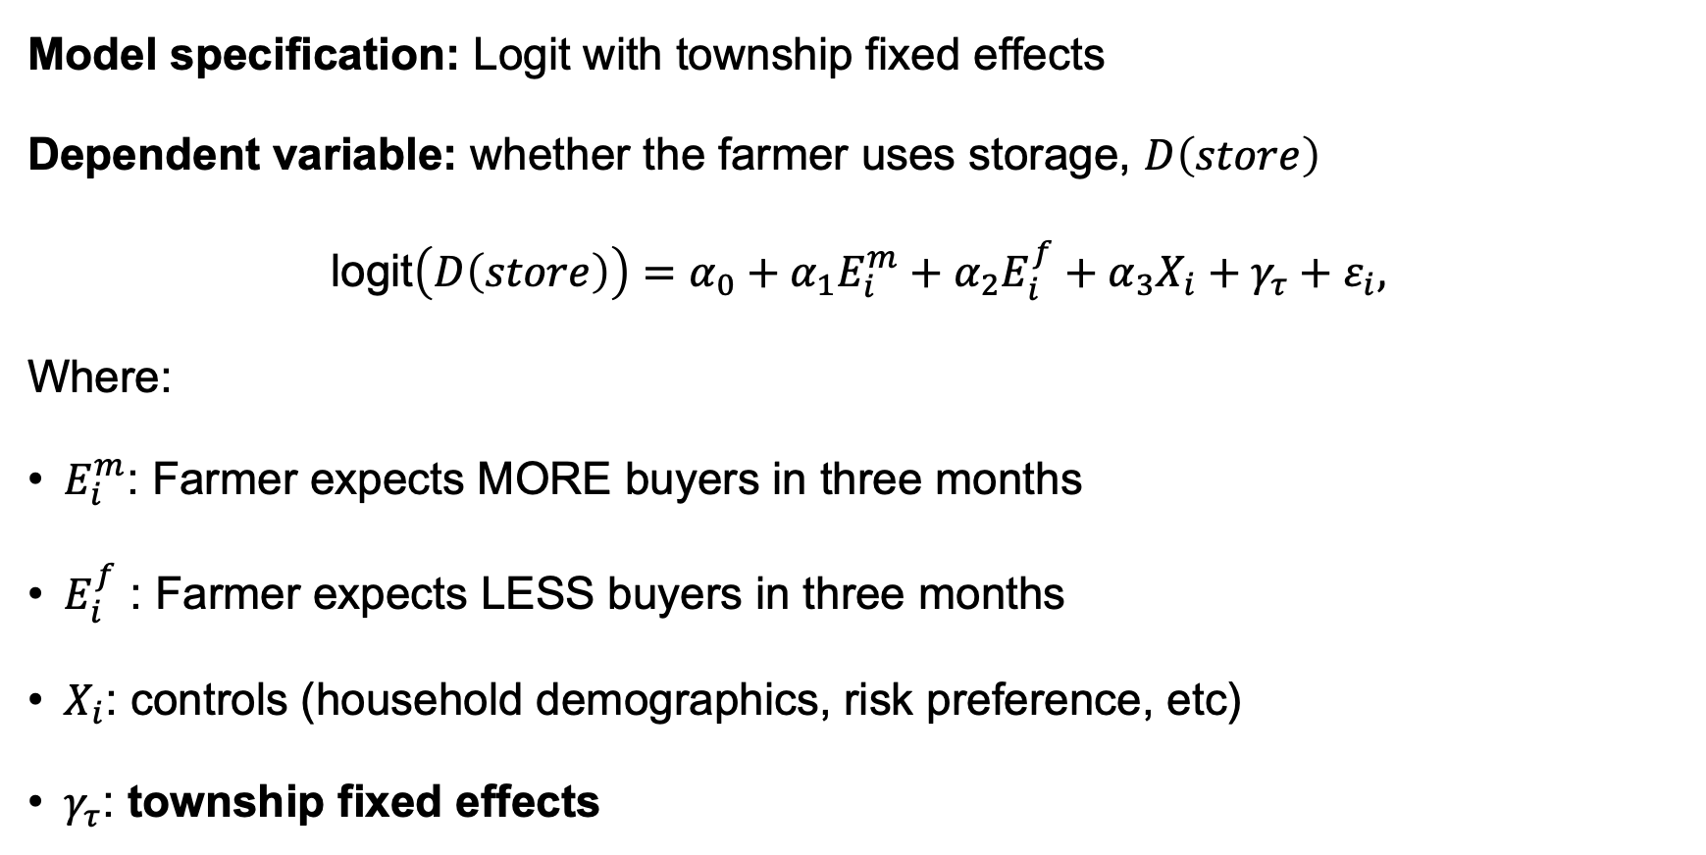
6.7. Farmer Storage Decisions: Farmers' Expectations of Buyer Competitiveness in three months
Model specification: Logit with township fixed effects
Dependent variable: whether the farmer uses storage, $D\left(store\right)$
$\text{logit}\left(D\left(store\right)\right)=α_{0}+α_{1}E_{i}^{m}+α_{2}E_{i}^{f}+α_{3}X_{i}+γ_{τ}+ε_{i},$
Where:
$E_{i}^{m}$: Farmer expects MORE buyers in three months
$E_{i}^{f}$ : Farmer expects LESS buyers in three months
$X_{i}$: controls (household demographics, risk preference, etc)
$γ_{τ}$: township fixed effects

Slide 37
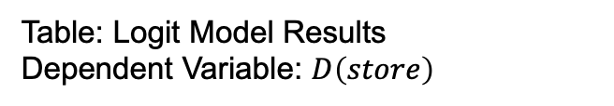
6.7. Farmer Storage Decisions: Farmers' Expectations of Buyer Competitiveness in three months
Main Findings
Expecting stronger future competition raises storage probability by ~32.5 pp.
Asymmetric effect: more responsive to expected increases than decreases in buyers.
Behavioral logic: storage is forward-looking—anticipation of higher future prices drives delay.
Data Constraint: only 16% expect fewer future buyers, limiting variation and statistical power.
Table: Logit Model Results
Dependent Variable: $D\left(store\right)$
Variable | Average Marginal Effect | Significance
Expect More Buyers | +0.325 | p<0.01
Expect Less Buyers | +0.044 | NO
Age | -0.003 | p<0.1
Village Leader Family | +0.105 | p<0.01
Risk Aversion | -0.100 | p<0.01
Correlation Matrix of Controls

Slide 38
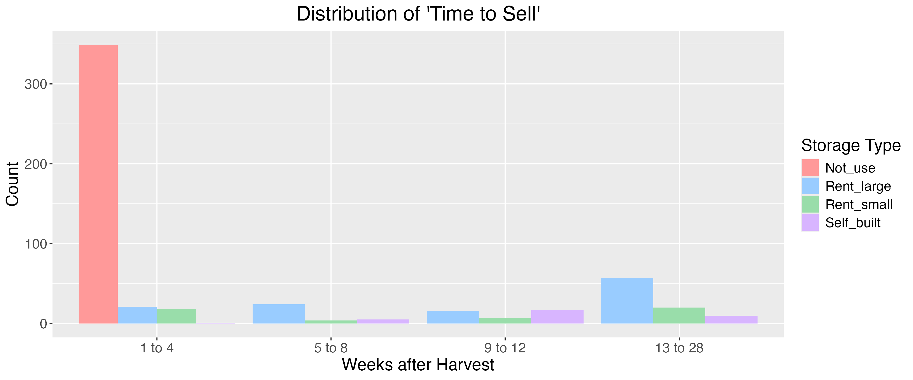
6.8. Time to Sell: Expected Buyer Movement
Model Specification:
Accelerated Failure Time (AFT) model (hazard framework)
Key Independent Variable: Farmers’ expectations about future buyer competition
A positive coefficient indicates a longer storing time (delayed sales), while a negative coefficient implies a shorter storing time (earlier sales).

Slide 39
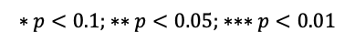
6.8. Time to Sell: Expected Buyer Movement
Table: Extended Weibull Survival Model Results
Dependent Variable: Interval between harvest and sale (in weeks)
Key Independent Variable | Full Sample | Storers ONLY | Interpretation
Expect MORE buyer | 0.50*** | 0.12 | Farmers with optimistic expectations delay sales
Expect LESS buyer | -0.05 | -0.21* | storage users expecting downturns sell earlier
Controls | Full Sample | Storers ONLY | Interpretation
Distance to Small Storage | -0.30*** | -0.14 | Greater distance raises transaction costs, prompting earlier sales
Distance to Large Storage | 0.01 | -0.13 | —
Purpose: More Marketing Channels | 0.33*** | -0.11 | Farmers seeking new channels or better bargaining terms tend to wait longer
Purpose: Better Bargaining Position | 0.27*** | -0.05
$$∗p<0.1; ∗∗p<0.05; ∗∗∗p<0.01$$
Notes:
被解释变量：粮食/水果在仓库里待了多久

Slide 40
7.1. Some Notable Field Observations
Low collective efficiency: Collective cold storages are underused due to small harvest-to-capacity ratios and unclear user rights—typical collective asset underuse (Kong & Gao, 2017)
Strategic signaling: Many farmers use storage to signal capacity and deter buyers rather than to really delay sales
High entry cost: A 20-ton private unit costs ≈100,000 RMB—about five times mean annual farm income
Seasonal shortage: By November, storage facilities fill quickly and rental prices stay stable, limiting capacity

Slide 41
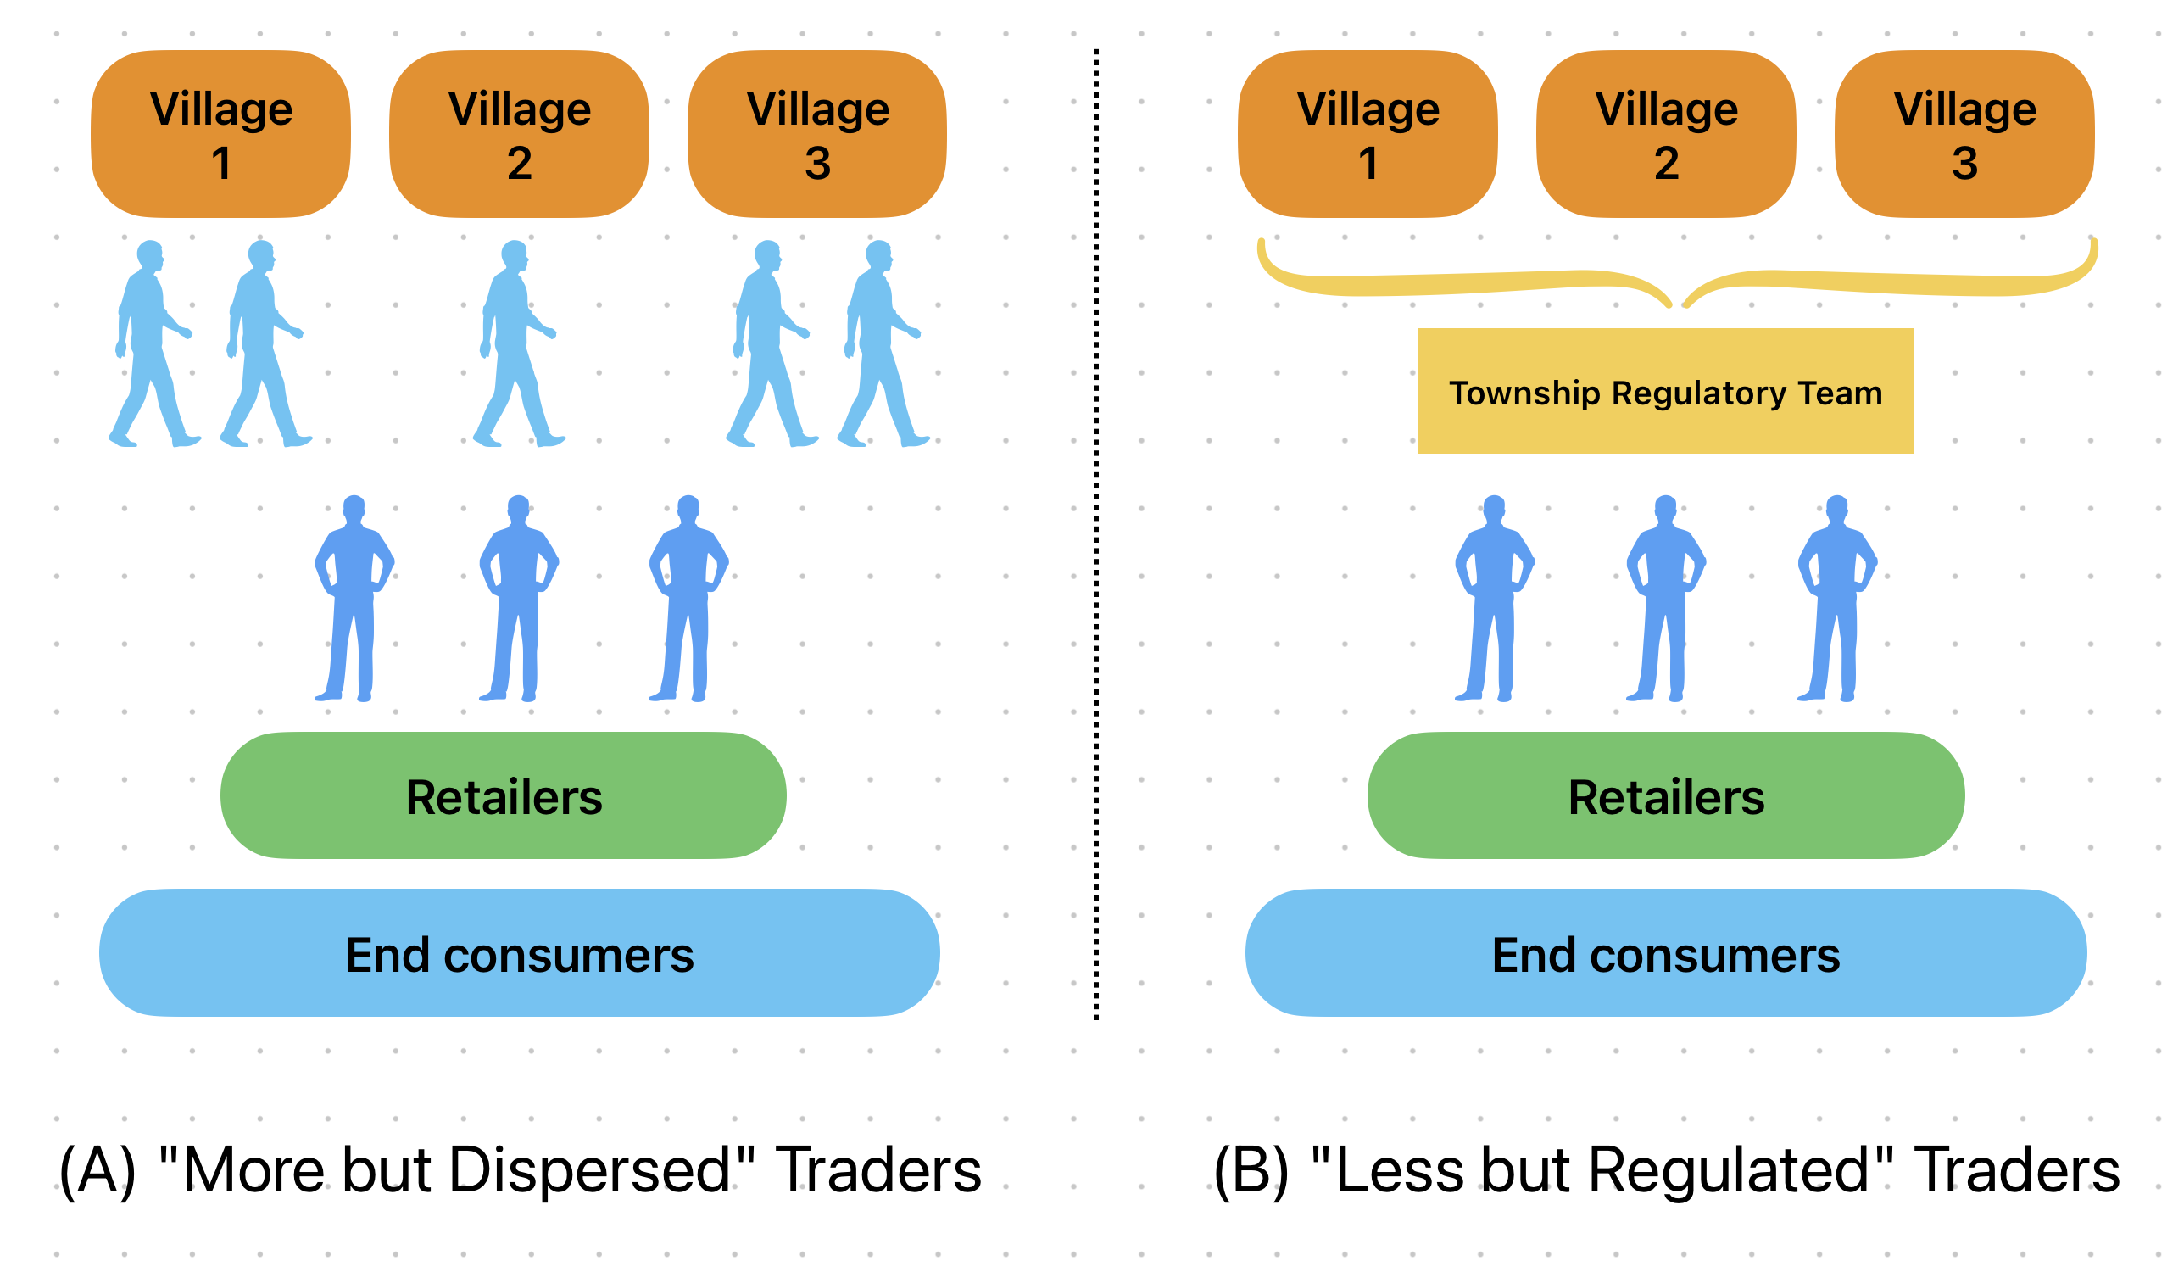
7.2. Strengthening Competition: More Is Not Always Better
Cooperative paradox: Many cooperatives are captured by a few elites, so policy benefits fail to reach ordinary smallholders (Zhong, 2018).
Large specialized households and family farms: Raise concerns about the fairness of policy benefit distribution.
Core question: Who truly represents the bargaining interests of the majority of small farmers?

Slide 42
7.3. Model Extensions
More than 2 Periods
Time-varying Supply Elasticity
Risk Aversion: Loss Aversion
Trader’s Response:
Collective-Action Dilemma
Non-linear Storage Cost

Slide 43
7.4. Apple Futures: The World’s Only Fresh-Fruit Contract
Launch: China’s apple futures, introduced in 2017 on the Zhengzhou Commodity Exchange, are the world’s only fresh-fruit futures
Features: Unlike grains, apples are perishable with short storage lives and high losses
Policy goal: Provide transparent price discovery and risk-management tools to stabilize farm income
Challenges: Participation is minimal—<0.1% of farmers engage directly due to capital and knowledge barriers

Slide 44
8. Conclusion
Economic role of storage
Enables farmers to move beyond “sell-at-harvest” constraints and profit from shifting buyer competition
Literature contribution
Reframes storage from a market-competition perspective, showing how it takes advantage of time-varying buyer power
Policy and broader relevance
Applicable to markets where upstream input supply is competitive but downstream trading is concentrated or collusive.
Expanding storage access and efficiency can enhance producer welfare and inform market-based smallholder development strategies in developing countries.

Slide 45
Thank you so much for your time and attention.
yaoma@ucdavis.edu
Tel: +1 (805)-637-4568
UC Davis
YaoEconomics.weebly.com

Slide 46
9. Reference
Aggarwal, S., Francis, E., & Robinson, J. (2018). Grain today, gain tomorrow: Evidence from a storage experiment with savings clubs in Kenya. Journal of Development Economics, 134, 1–15.
Ai, J., Pei, J., & Yang, A. (2024). Spatial competition and market power in China’s agricultural markets. Working Paper. https://www.gtap.agecon.purdue.edu/resources/res_display.asp?RecordID=7268
Anand, K., Anupindi, R., & Bassok, Y. (2008). Strategic inventories in vertical contracts. Management Science, 54(10), 1792–1804.
Barrett, C. B., & Mutambatsere, E. (2008). Agricultural markets in developing countries. In S. Durlauf & L. Blume (Eds.), The New Palgrave Dictionary of Economics, Springer.
Bellemare, M. F. (2022). Agricultural value chains: Towards a marriage of development economics and industrial organisation? Australian Journal of Agricultural and Resource Economics, 66(2), 241–255.
Bergquist, L.F. & Dinerstein, M. (2020). Competition and entry in agricultural markets: Experimental evidence from Kenya. American Economic Review 110(12): 3705–3747.
Burke, M., Bergquist, L.F. & Miguel, E. (2019). Sell low and buy high: Arbitrage and local price effects in Kenya. QJE 134(2): 785–842.
Cardell, L. & Michelson, H. (2023). Price risk and small farmer maize storage in Sub-Saharan Africa. AJAE 105(3): 737–759.
Chatterjee, S. (2023). Market power and spatial competition in rural India. QJE 138(3): 1649–1711.
Deaton, A. & Laroque, G. (1992). On the behaviour of commodity prices. Review of Economic Studies 59(1): 1–23.
Fafchamps, M. & Hill, R.V. (2005). Selling at the farmgate or traveling to market. AJAE 87(3): 717–734.
Grau, A., & Hockmann, H. (2018). Market power in the German dairy value chain. Agribusiness, 34(1), 93–111.

Slide 47
9. Reference
Huang, J., Su, L., Huang, Q. & Liu, X. (2022). Facilitating inclusive ICT application and e-commerce development in rural China. Agricultural Economics 53(6): 938–952.
Janzen, J.P., Paulson, N.D. & Tsay, J.-H. (2024). Commodity storage and the cost of capital: Evidence from Illinois grain farms. AJAE 106(2): 526–546.
Ji, I., Chung, C., & Lee, J. (2017). Measuring oligopsony power in the U.S. cattle procurement market: Packer concentration, cattle cycle, and seasonality. Agribusiness, 33(1), 16–29.
Kahneman, D. & Tversky, A. (1979). Prospect theory: An analysis of decision under risk. Econometrica 47(2): 263–292.
Kopp, T. & Sexton, R.J. (2021). Buyer market power and double marginalization in Indonesia. AJAE 103(2): 543–568.
Li, L. (1992). The role of inventory in delivery-time competition. Management Science, 38(2), 182–197.
Mérel, P., & Sexton, R. J. (2017). Buyer power with atomistic upstream entry: Can downstream consolidation increase production and welfare? International Journal of Industrial Organization, 50, 259–293.
Mérel, P.R., Sexton, R.J. & Suzuki, A. (2009). Transportation infrastructure when middlemen have power. AJAE 91(2): 462–476.
Mitra, S., Mookherjee, D., Torero, M., & Visaria, S. (2018). Asymmetric information and middleman margins: An experiment with Indian potato farmers. Review of Economics and Statistics, 100(1), 1–13.
Park, A. (2006). Risk and household grain management in developing countries. The Economic Journal, 116(514), 1088–1115.
Richards, T. J., Patterson, P. M., & Acharya, R. N. (2001). Price behavior in a dynamic oligopsony: Washington processing potatoes. American Journal of Agricultural Economics, 83(2), 259–271.
Rubens, M. (2023). Market structure, oligopsony power, and productivity. American Economic Review 113(9): 2382–2410.

Slide 48
9. Reference
Ruhinduka, R. D., Alem, Y., Eggert, H., & Lybbert, T. (2020). Smallholder rice farmers’ post-harvest decisions: Preferences and structural factors. European Review of Agricultural Economics, 47(4), 1587–1620.
Saha, A. & Stroud, J. (1994). A household model of on-farm storage under price risk. AJAE 76(3): 522–534.
Saitone, T.L., Sexton, R.J. & Malan, B. (2018). Price premiums, payment delays, and default risk: Why farmers choose cooperatives vs. private traders. Agricultural Economics 49(3): 363–380.
Sexton, R.J. & Zhang, M. (2001). An assessment of the impact of food industry market power on U.S. consumers. Agribusiness 17(1): 59–79.
Sexton, R.J. (2000). Industrialization and consolidation in the U.S. food sector. AJAE 82(5): 1087–1104.
Sexton, R.J. (2013). Market power, misconceptions, and modern agricultural markets. AJAE 95(2): 209–219.
Sitko, N. J., & Jayne, T. S. (2014). Exploitative briefcase businessmen, parasites, and other myths and legends: Assembly traders and the performance of maize markets in Eastern and Southern Africa. World Development, 54, 56–67.
Sudhir, K., Chintagunta, P. K., & Kadiyali, V. (2005). Time-varying competition. Marketing Science, 24(1), 96–109.
Working, H. (1949). The theory of price of storage. American Economic Review 39(6): 1254–1262.
Wright, B.D. & Williams, J.C. (1984). The welfare effects of the introduction of storage. Quarterly Journal of Economics 99(1): 169–192.
孔祥智, & 高强. (2017). 改革开放以来我国农村集体经济的变迁与当前亟需解决的问题. 经济研究：理论探索, (1), 116–122.
温铁军 等. (2009). 部门和资本“下乡”与农民专业合作经济组织的发展. 经济理论与经济管理, (7), 5–12.
钟真. (2018). 改革开放以来中国新型农业经营主体：成长、演化与走向. 中国人民大学学报, 32(4), 43–55.

Slide 49
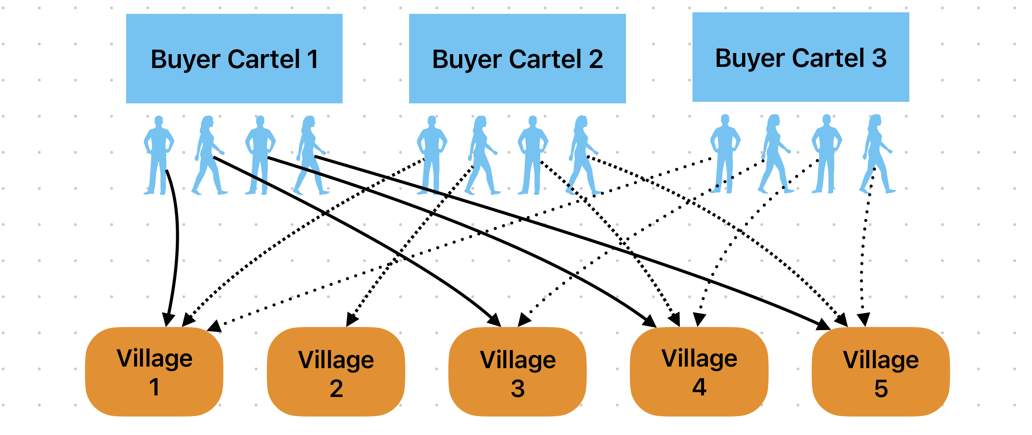
1. Motivation: Buyer Collusion and Competition
Back
Notes:
就如这张图所示，在同一个镇内，可能会有多个小型收购联盟。
每一个小型联盟会在苹果收获季前在县城的宾馆里抽烟喝酒、开会，定下来谁能去哪个村收购。
但是不同Cartel之间是很难保持长期共谋关系的！因此，去往各村的买家数量和相互之间的合作程度是会随着时间而变化的。
买方势力的时间层面的异质性很可能就是这样产生的。

Slide 50
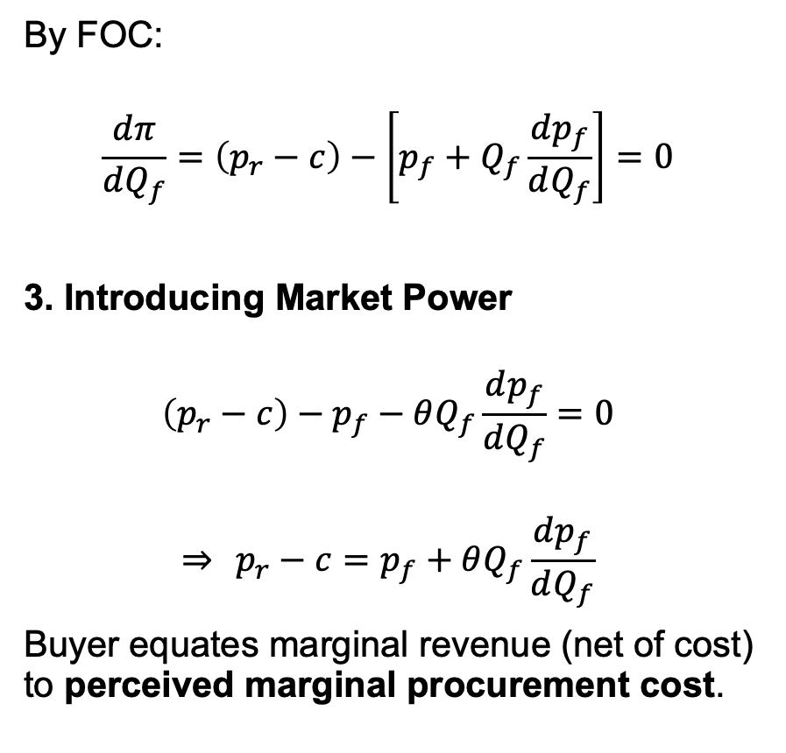
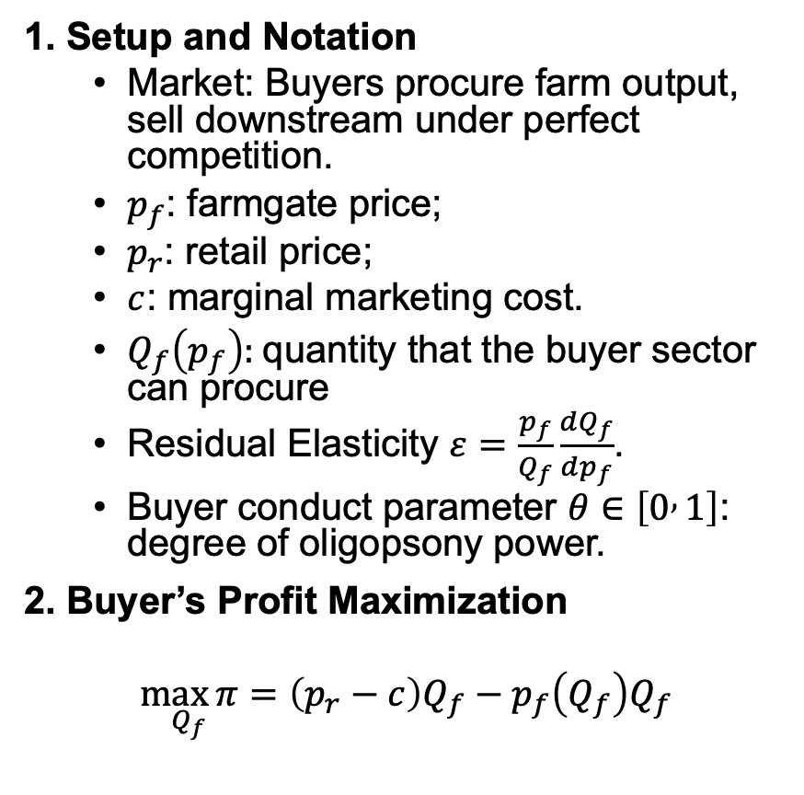
10. Appendix Derivation of Farm Price under FOOM Framework (1)
1. Setup and Notation
Market: Buyers procure farm output, sell downstream under perfect competition.
$p_{f}$: farmgate price;
$p_{r}$: retail price;
$c$: marginal marketing cost.
$Q_{f}\left(p_{f}\right):$quantity that the buyer sector can procure
Residual Elasticity $ε=\frac{p_{f}}{Q_{f}}\frac{dQ_{f}}{dp_{f}}$.
Buyer conduct parameter $θ∈\left[0 , 1\right]$: degree of oligopsony power.
2. Buyer’s Profit Maximization
$$\underset{Q_{f}}{\max{π}}=\left(p_{r}−c\right)Q_{f}−p_{f}\left(Q_{f}\right)Q_{f}$$
By FOC:
$$\frac{dπ}{dQ_{f}}=\left(p_{r}−c\right)−\left[p_{f}+Q_{f}\frac{dp_{f}}{dQ_{f}}\right]=0$$
3. Introducing Market Power
$$\left(p_{r}−c\right)−p_{f}−θQ_{f}\frac{dp_{f}}{dQ_{f}}=0$$
$$⇒ p_{r}−c=p_{f}+θQ_{f}\frac{dp_{f}}{dQ_{f}}$$
Buyer equates marginal revenue (net of cost) to perceived marginal procurement cost.
Back

Slide 51
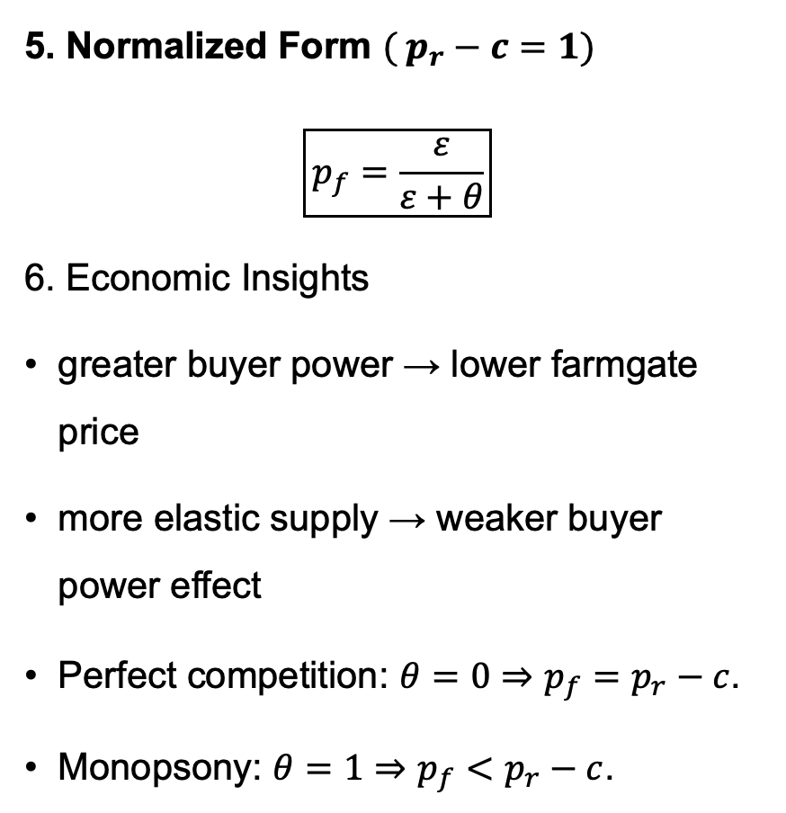
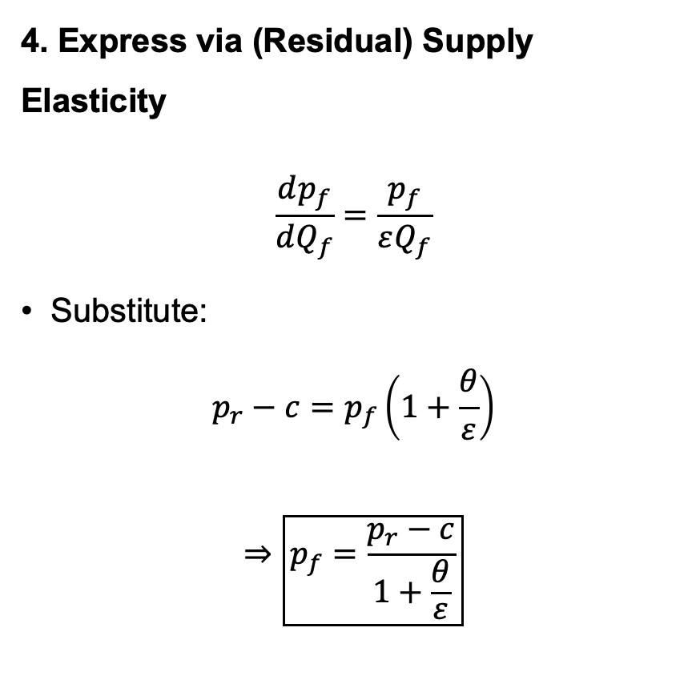
10. Appendix Derivation of Farm Price under FOOM Framework (2)
4. Express via (Residual) Supply Elasticity
$$\frac{dp_{f}}{dQ_{f}}=\frac{p_{f}}{εQ_{f}}$$
Substitute:
$$p_{r}−c=p_{f}\left(1+\frac{θ}{ε}\right)$$
$$⇒\boxed{p_{f}=\frac{p_{r}−c}{1+\frac{θ}{ε}}}$$
5. Normalized Form $( p_{r}−c=1)$
$$\boxed{p_{f}=\frac{ε}{ε+θ}}$$
6. Economic Insights
greater buyer power → lower farmgate price
more elastic supply → weaker buyer power effect
Perfect competition: $θ=0⇒p_{f}=p_{r}−c$.
Monopsony: $θ=1⇒p_{f}<p_{r}−c$.
Back

Slide 52
5.2. Simulation of Optimal Storage Shares (Complete)
Back

Slide 53
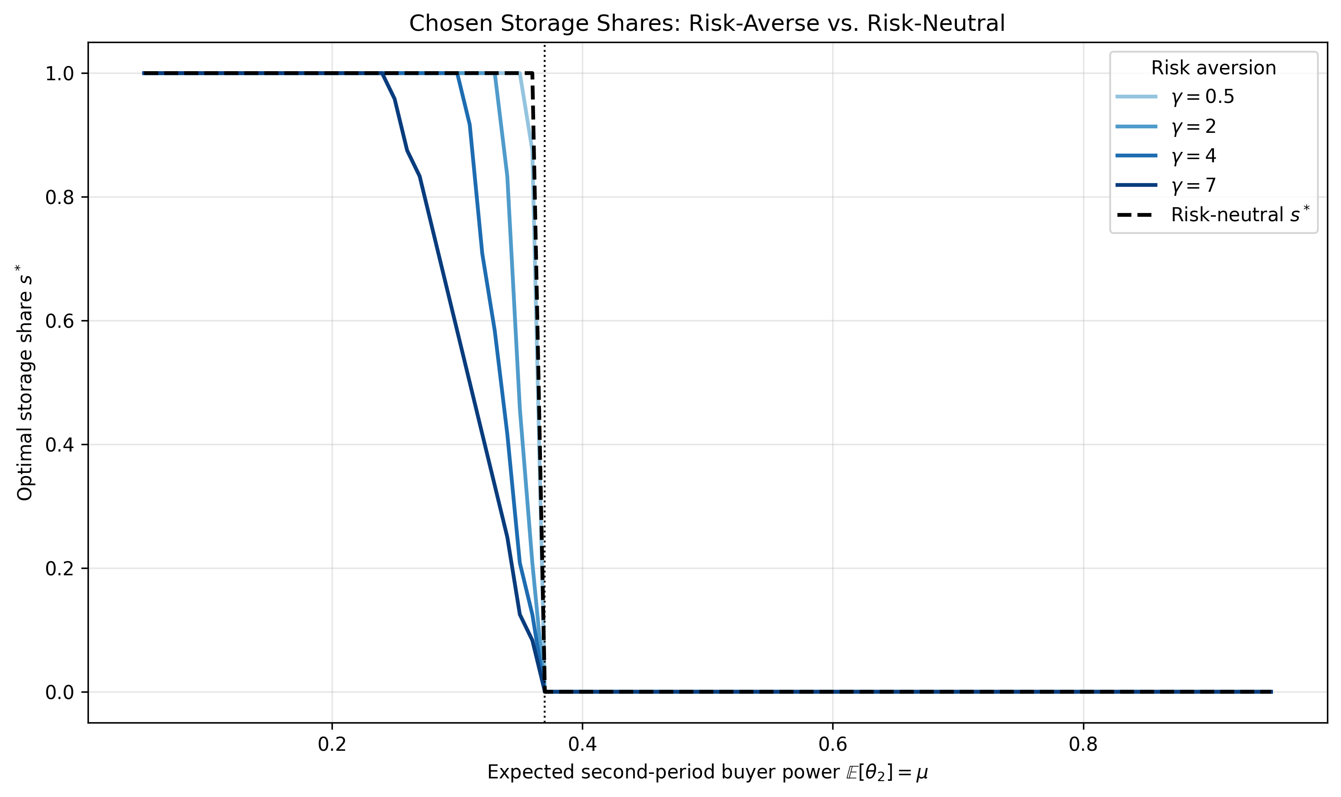
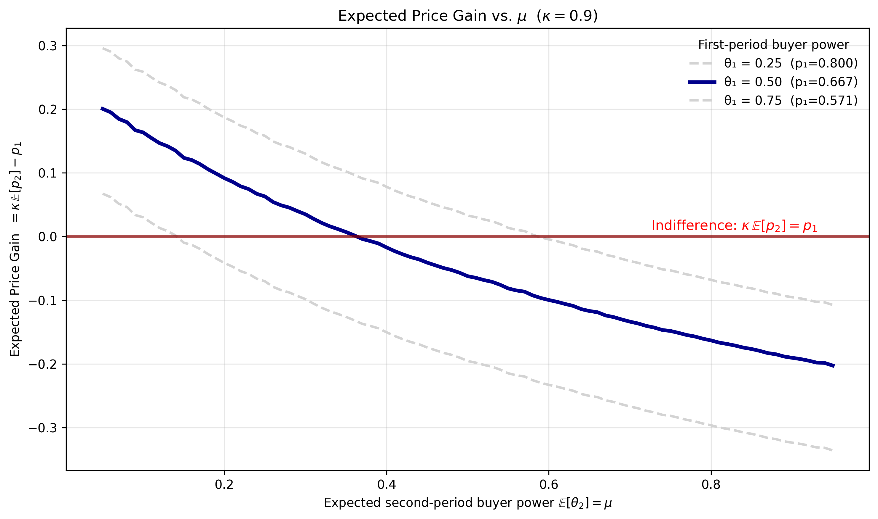
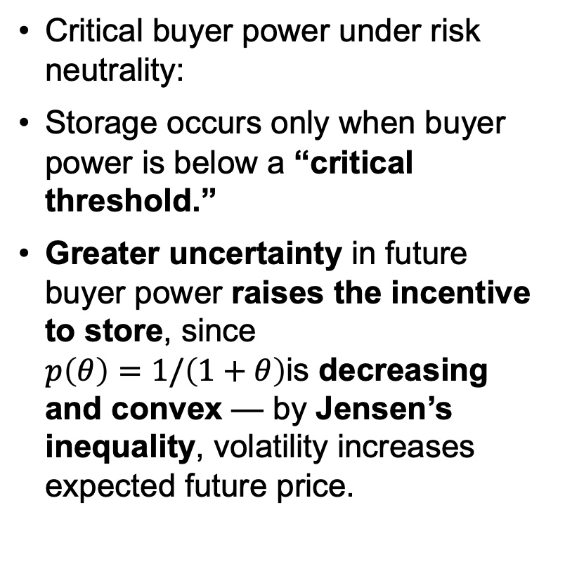
5.2.Sensitivity: Expected Future Buyer Power
Critical buyer power under risk neutrality:
Storage occurs only when buyer power is below a “critical threshold.”
Greater uncertainty in future buyer power raises the incentive to store, since $p\left(θ\right)=1/\left(1+θ\right)$is decreasing and convex — by Jensen’s inequality, volatility increases expected future price.
Back

Slide 54
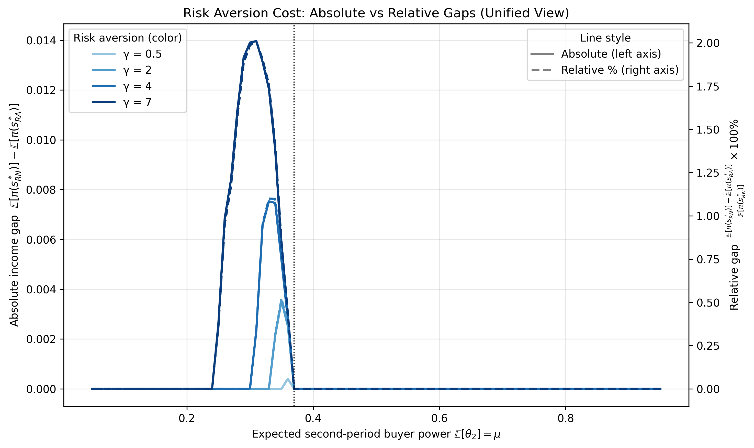
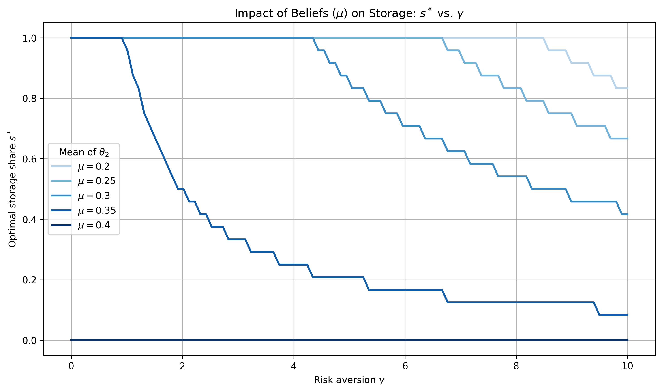
5.2.Sensitivity: Risk Aversion
As risk aversion rises, the optimal storage share (s) declines or stay the same.
The curve flattens in mid ranges — welfare loss from risk aversion is limited but concentrated near the indifference threshold, where storing is neither clearly profitable nor unprofitable.
Back

Slide 55
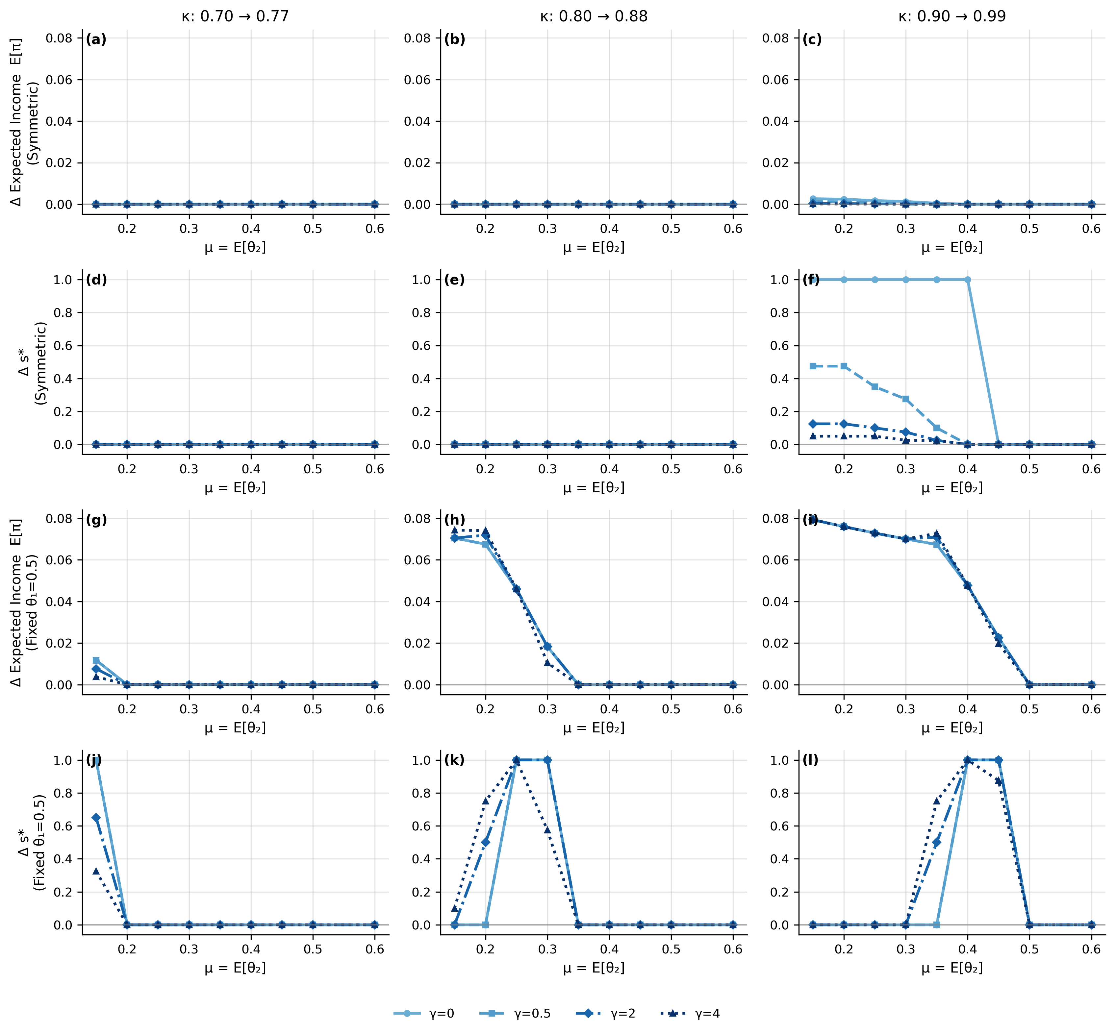
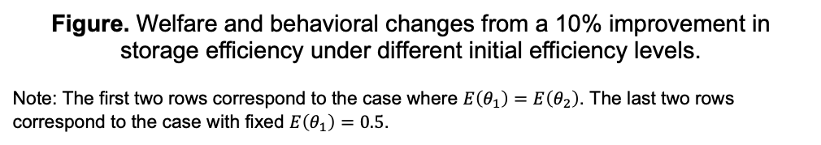
5.2.Sensitivity: Storage Efficiency
Marginal storers drive most welfare gains — those who start storing once efficiency improves
Effects depend on market structure and initial efficiency: gains are largest under strong buyer power or high initial efficiency
Figure. Welfare and behavioral changes from a 10% improvement in storage efficiency under different initial efficiency levels.
Note: The first two rows correspond to the case where $E\left(θ_{1}\right)=E\left(θ_{2}\right)$. The last two rows correspond to the case with fixed $E\left(θ_{1}\right)=0.5$.
Back

Slide 56
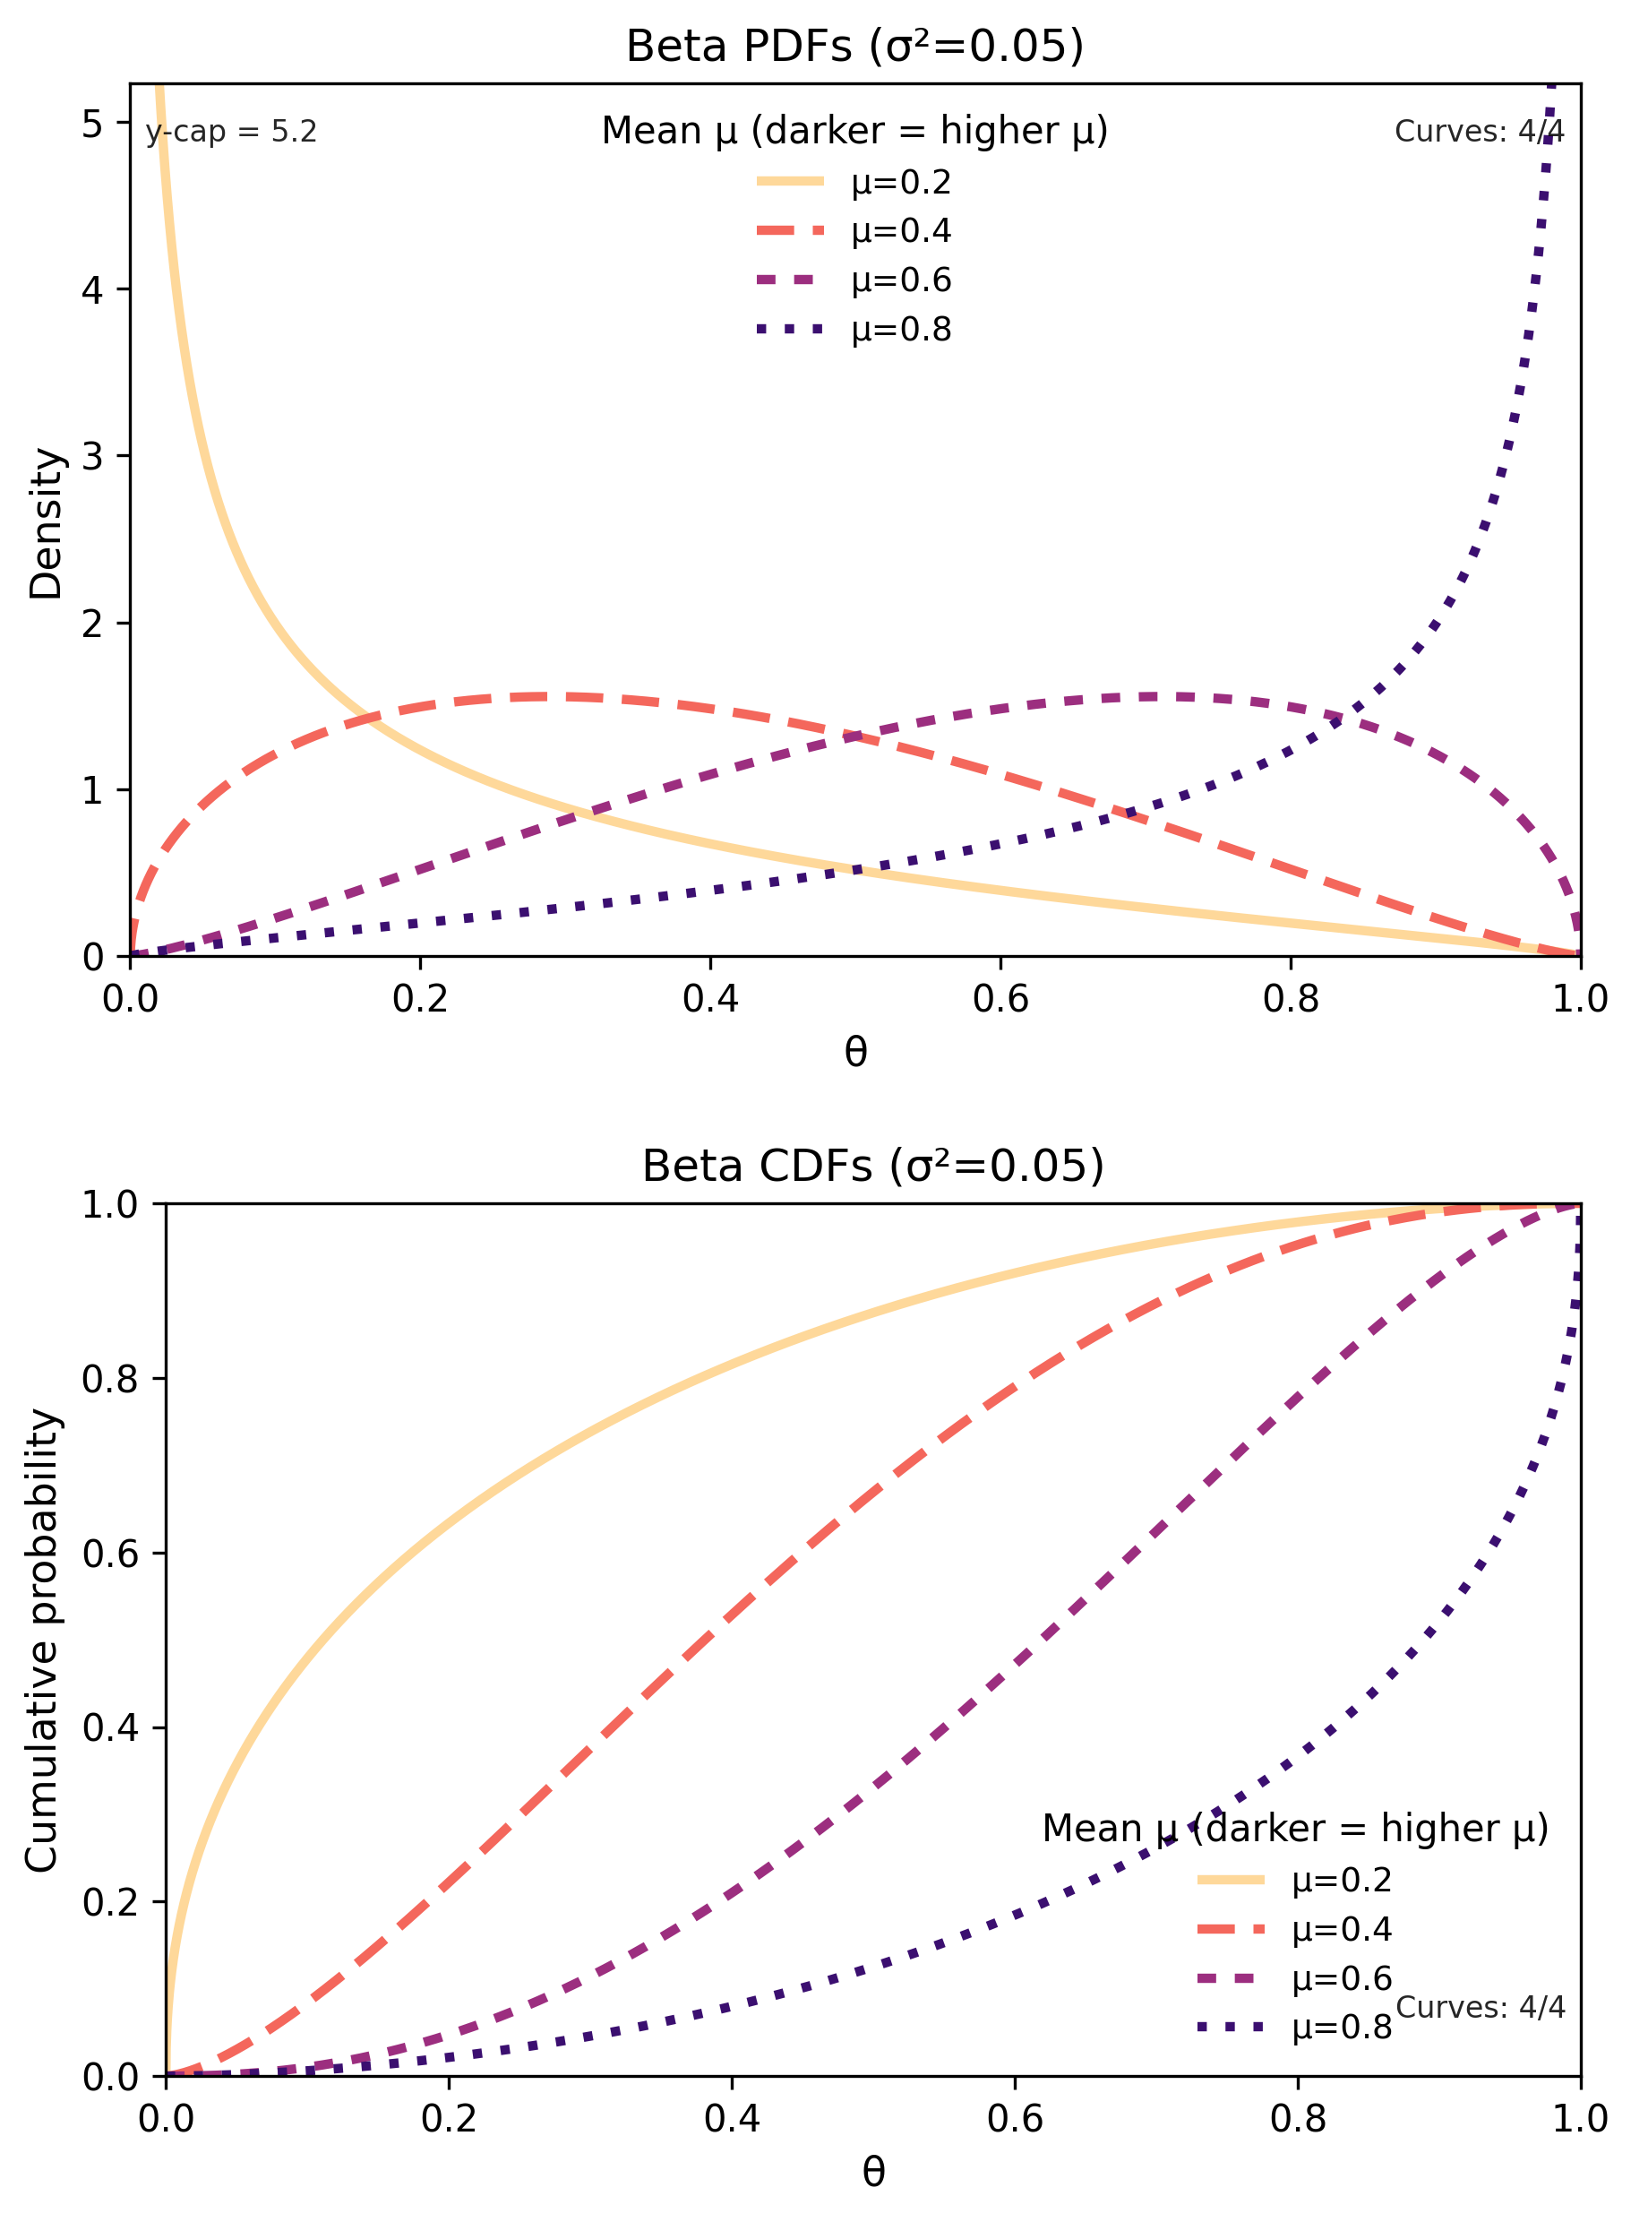
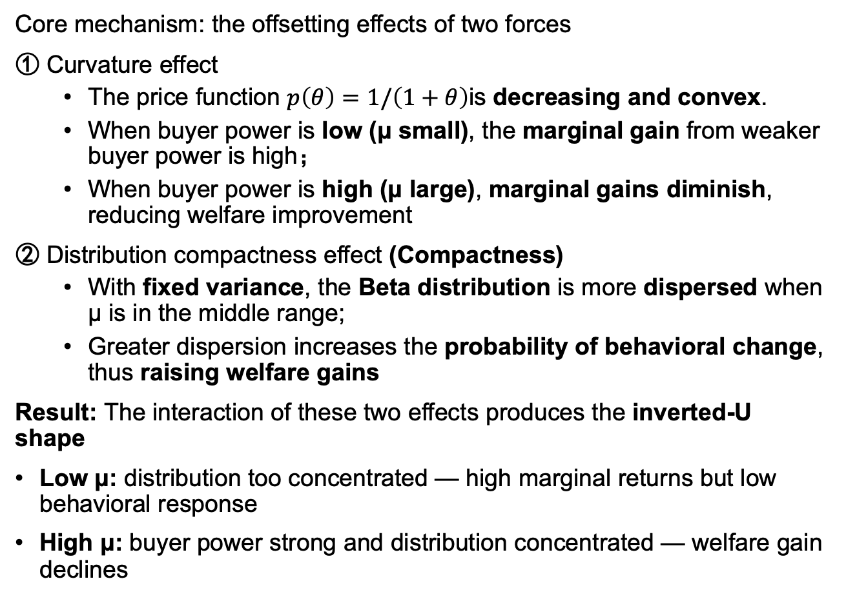
10. Appendix Why does expected income gain show an inverted-U pattern?
Core mechanism: the offsetting effects of two forces
① Curvature effect
The price function $p\left(θ\right)=1/\left(1+θ\right)$is decreasing and convex.
When buyer power is low (μ small), the marginal gain from weaker buyer power is high；
When buyer power is high (μ large), marginal gains diminish, reducing welfare improvement
② Distribution compactness effect (Compactness)
With fixed variance, the Beta distribution is more dispersed when μ is in the middle range;
Greater dispersion increases the probability of behavioral change, thus raising welfare gains
Result: The interaction of these two effects produces the inverted-U shape
Low μ: distribution too concentrated — high marginal returns but low behavioral response
High μ: buyer power strong and distribution concentrated — welfare gain declines
Back

Slide 57
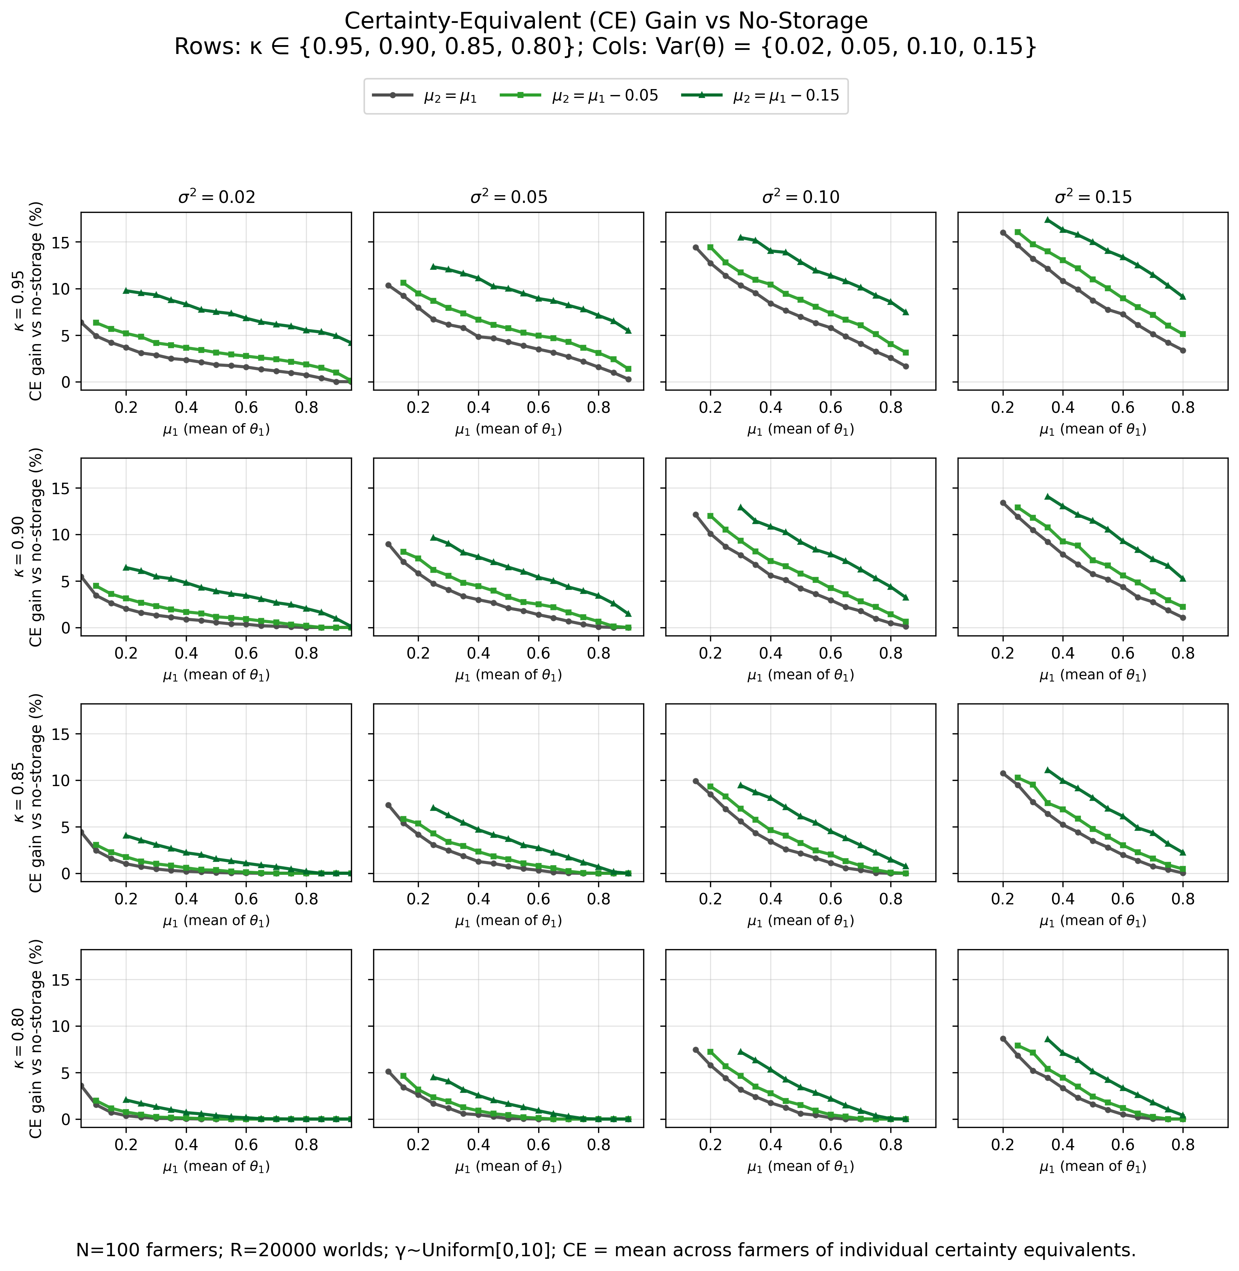
5.3. Village-level Welfare Simulation: Percent CE income gain relative to no-storage
Back
Notes:
风险厌恶的抑制效应： 当 $κ$与 $σ^{2}$较高时，期望收益可能随 $μ_{1}$呈现倒U形变化；但在考虑效用函数曲率后，确定性等价（CE）收益对 $μ_{1}$呈单调递减关系，表明风险厌恶消除了倒U形特征。

Slide 58
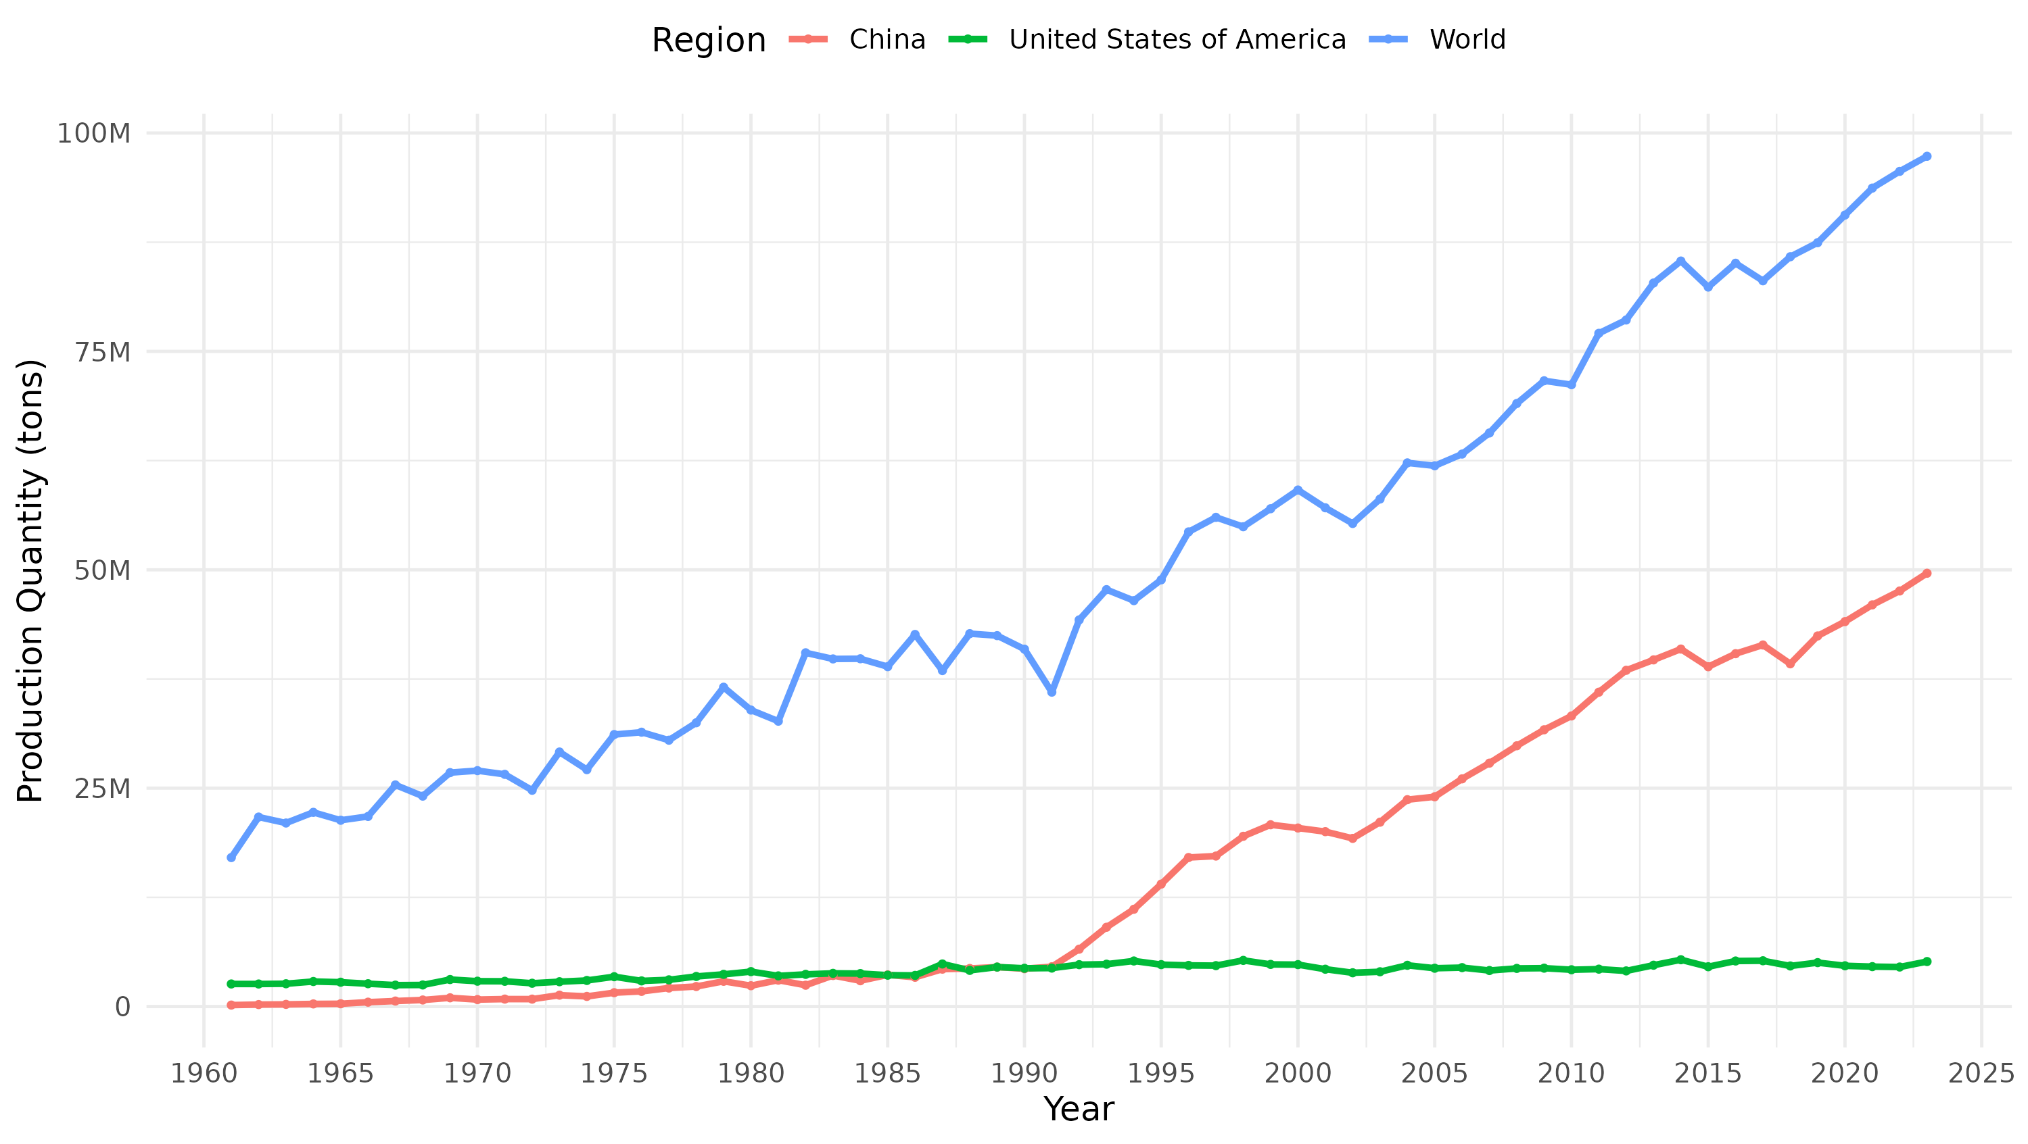
10. Appendix Overview of Fresh Apple Industry in China
（1）Global Leadership and a Vast Domestic Market
Global position: Since the 1990s, China has produced over half of the world’s apples, remaining the largest producer globally
Production trend: Output has continued to rise for decades
Reform driver: Apples were among the first agricultural products to be liberalized after China’s economic reforms. Market opening, price reforms, and private investment transformed apples into a key income source for low-income regions in central and western China
（2）Latest statistics (2024)
Planting area: about 30 million mu
Output: about 50 million tons
Variety: Fuji apples account for 75%
Global Share:
Production: ≈ 55% of world total
Consumption: ≈ 53% of world total
(Sources: National Bureau of Statistics, 2024; USDA, 2024)
Back

Slide 59
10. Appendix Measuring Farmers’ Risk Preferences
Following Jin et al. (2024), this study combines two complementary approaches:
Subjective scale method: A five-point risk preference scale (1 = “extremely risk-averse,” 5 = “very risk-seeking”) captures farmers’ self-assessed attitudes toward risk.
Behavioral experiment: An incentivized, modified Holt–Laury coin-flip lottery is used to experimentally elicit farmers’ risk preferences with real monetary payoffs.
Option | Willing to Pay (RMB) | Results | Expected Gain Gap (EVᵃ–EVᵇ) | CRRA Range | Adjusted CRRA
1 | 120 | 200 RMB or 0 RMB | 20 | –0.4 < γ < 0 | γ = –0.2
2 | 100 | 200 RMB or 0 RMB | 0 | 0 < γ < 0.2 | γ = 0.1
3 | 80 | 200 RMB or 0 RMB | –20 | 0.2 < γ < 0.4 | γ = 0.3
4 | 60 | 200 RMB or 0 RMB | –40 | 0.4 < γ < 0.6 | γ = 0.5
5 | 40 | 200 RMB or 0 RMB | –60 | 0.6 < γ < 0.7 | γ = 0.6
6 | 20 | 200 RMB or 0 RMB | –80 | γ > 0.7 | γ = 0.9
Back

Slide 60
10. Appendix Measuring Farmers’ Liquidity Constraints
Definition and criteria: Following Albuquerque et al. (2024) and Stephens and Barrett (2011), a household is considered liquidity-constrained if it reports both:
Difficulty obtaining credit, and
A need to sell apples immediately after harvest due to urgent cash demands (e.g., tuition, medical expenses).
Findings: About 15% of farmers meet this criterion, yet their storage and selling behaviors do not differ significantly from others.
This likely reflects two factors:
High credit availability in Yanchang County, a provincial rural revitalization pilot area; and
A widespread precautionary saving mindset formed after past shocks (e.g., hailstorms), fostering financial prudence and self-insurance behavior.
Back

Slide 61

10. Appendix Demographic Characteristics by Storage Usage Type
Back

Slide 62

10. Appendix Sources of Price Information by Type of Storage Use
Back

Slide 63

Fresh Apple Price Trend (Preliminary Survey)
Back

Slide 64

Farmer Storage Decisions and Expectations of Future Buyer Competition
Correlation checks for control variables:
Age and education: negatively correlated (ρ = –0.18), consistent with younger and better-educated farmers being more market-oriented.
Risk aversion: shows low correlation with other variables, suggesting an independent effect on storage behavior.
Subjective competition rating vs. objective buyer count: positively correlated (ρ = 0.79), yet the two capture distinct dimensions of market perception.
Back

